Slide 1
General Finance Matters
Chris Patten and Stephen Kent Taylor

Slide 2
TES Billing
Can we make it better?

Slide 3
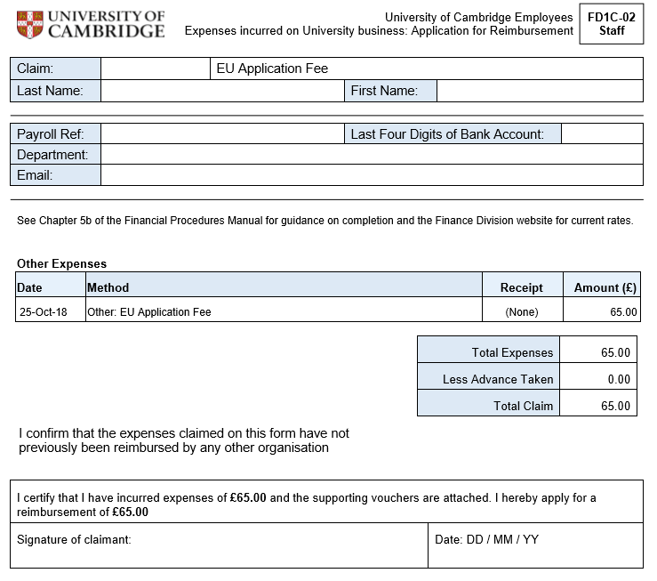
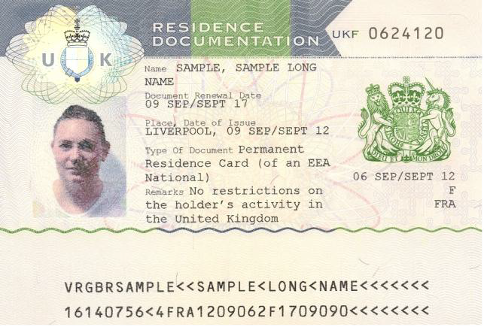
Help with the cost of Permanent Residence Cards

Slide 4
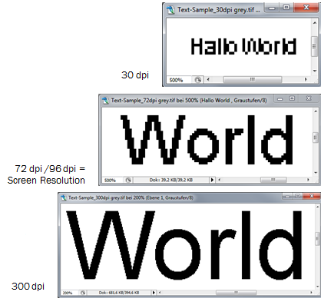
Scanning quality – 300dpi
Recommended scan setting is 300dpi (dots per inch). Can go higher, but limited benefit and file size can become an issue.
This is required for the scanning pilot, but recommended for all document scanning.
Ideally, set your scanner/photocopier to default to this resolution.
As we move towards the paperless utopia this becomes more and more relevant.

Slide 5
Questions?

Slide 6
Finance Systems Update
Michelle Bond
Lead Functional Analyst
michelle.bond@admin.cam.ac.uk

Slide 7
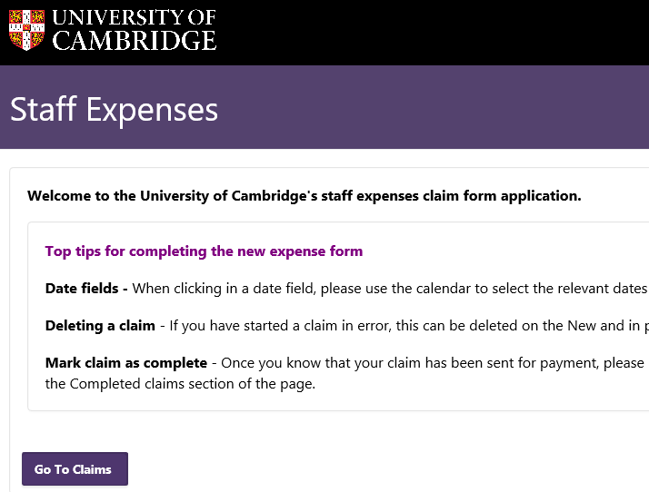
Employee Expense form – LIVE 18 October
Old system no longer supported
Same technology as new Supplier database
Platform for more streamlined process

Slide 8
Java Palaver – 31 October
Minimum supported version for Java for CUFS is now 1.8.0_181
Please contact your computer officer should you have any queries

Slide 9
Critical and Security Patching
Code Freeze
21 Nov
Testing completed Centrally
Downtime Fri 11 Jan to Mon 14 Jan
One change for users
Code Freeze
15 Jan

Slide 10
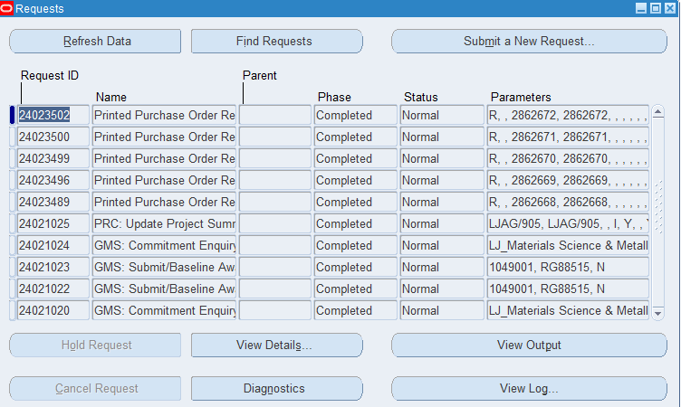
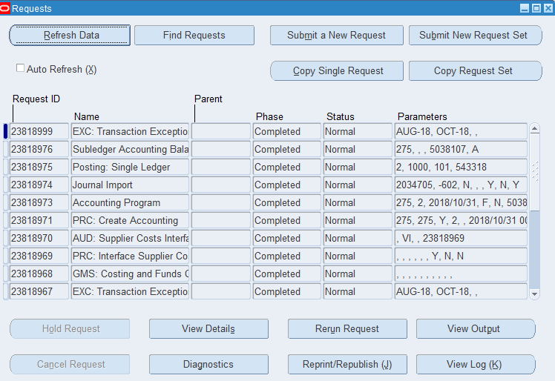
Critical and Security Patching – View Requests
Now
Patched

