Slide 1
Cambridge Casual Worker System
Wednesday 26 April 2023

Slide 2
CCWS Overview
CCWS was introduced to address:-
Right to Work and Visa compliance
To demonstrate compliance with Right to Work legislation
To monitor compliance with Tier 4 student visa working restrictions
Employment and Tax Legislation:-
To correctly assess employment status
To ensure workers are provided with terms and conditions on or before their first day of work
To enable timesheets to be submitted on a timely basis
Process and Systems
To provide consistency across departments
To be able to provide management information to enable departments to
manage their casual workforce more effectively

Slide 3
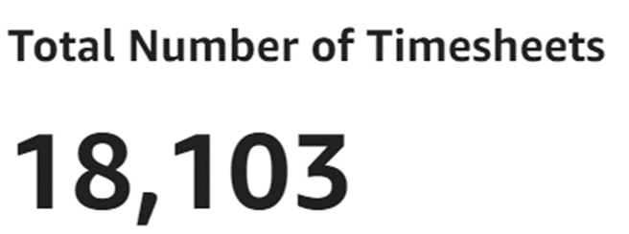
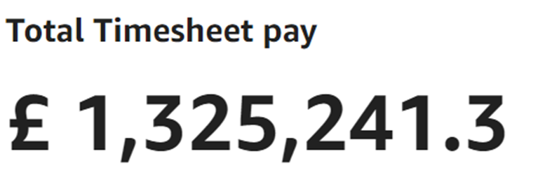
CCWS Quick Statistics
System Users
Workers | 3381
Department & Admin roles | 874

Slide 4
UPS2
UPS2 will close on 29 September 2023.
Please continue to ask your workers to submit any historic claims
for work prior to 2 January 2023 so these can be processed before UPS2 closes
UPS2 can only be used for the following:
Historic claims for work undertaken before 2 January 2023
Fee payments until the functionality is available in CCWS
As a holding position for any complex pay queries;
(only if advised to do so by the Tax Team or Casual Worker HR Team)

Slide 5
Undergraduate Examiner Process
To confirm the departments can either
Continue to use the Claim Form from Student Registry, or
Use CCWS to engage and pay their examiners and assessors.
Webinar on how to use the payment calculator and how to make a booking for undergraduate examiners and assessors in CCWS on Wednesday 3 May 2.00-3.30pm. Book your place.
Examination workshop due to take place on Tuesday 2 May 2023 with participants from the CCWS Project Team, Student Services, Tax Team and department representatives

Slide 6
Questions

