Slide 1
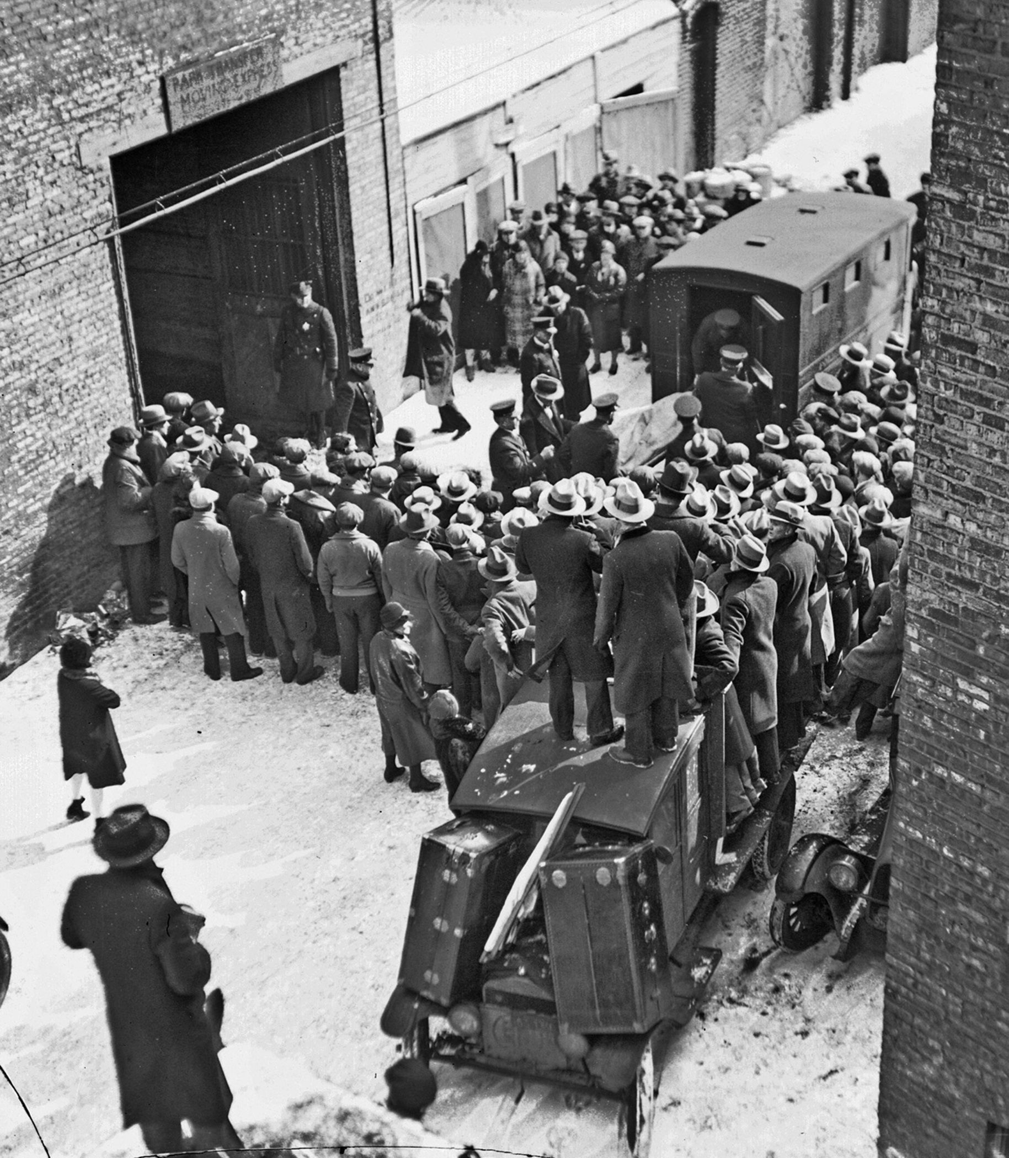

Welcome to
the February
Financial Users Group!

Slide 2


Financial Users Group
11 February 2022

Slide 3

Agenda
Welcome
Matters arising/action points
Finance Systems Replacement (FSR)
Finance Division updates
Questions and Answers

Slide 4


Portfolio Initiation
February 2022
Notes:
DB

Slide 5


Leadership
Sponsor
Daniel Benham
Business Lead
Mike Sinclair
Systems Lead
Michelle Bond
Project Manager
Steve Davis*
Support
Fulvia Carotenuto & Karen McCormack*
* Foraidan Consulting
Notes:
DB

Slide 6
Baseline

Slide 7
Objectives – from business case
The University’s Finance system (CUFS) was implemented around 20 years ago and it is no longer adequate for today’s operations. Academics, researchers and support staff across the University are frustrated by its outdated, inefficient and time-intensive procedures and it does not provide the financial transparency that is needed at all levels of the University.
The Programme will deliver a two-year design phase for its Financial Systems Replacement (FSR) project to replace CUFS. FSR will create a modern ‘backbone’ for the entire Programme that will update and streamline core finance processes and enable the improved data structures and functionality to unlock the full benefits and organisational reach of the Enhanced Financial Transparency (EFT) project. It also has significant synergies with and dependencies for Strategic Procurement and Purchasing (SPP).
FSR will deliver the foundation ‘platform of transformation’, facilitating joined-up process, data design and connectivity with programmes outside Finance in HR, Research and Estates. It will catalyse and support organisational / service delivery changes associated with RPS.
Our investment in cloud-based business systems, with coherent interfaced components, will provide flexibility for additional modules and functionality over time, with ongoing regular updates. This will allow our Finance operations to keep pace with future requirements through a manageable initial implementation of priority functionality, followed by evolutionary additional modules and regular updates.
This next phase of work will allow us to prepare a final business case by late 2022 for the implementation of a replacement Finance system expected to go-live in late 2025.
Notes:
DB

Slide 8
Finance Transformation Programme Board
Delivery Structure
Governance
Project Sponsor
Commissioning Board
Project Board
Steering Group
Directing
Senior User Group
Project Team
IT Focus Group
Managing
Project Board purpose and frequency
Work Stream User Groups
Work Stream Delivery team
Delivering
Approval and overview of the key areas and decisions made at project level.
Meeting monthly
Notes:
DB

Slide 9

Steps for success
Functionality Input – creation of work streams. Focus on “what must it do”, not “how does it do it”. Empower those with the knowledge to look at the bigger picture and future state
Technical Input – creation of work stream. Focus on digital and new technology. Empower those with the knowledge to use art of the possible lens
Challenge – question the status quo, don’t accept “that’s how we’ve always done it mentality
Project Liaison – work with other FTP projects to use lessons learned and find common ground. Cause and effect of scope decisions must be understood out with FSR
Principles – agree a key set of principles that challenge the current way of thinking and look to the future
Governance – creation of committees that provide representation of the University. Ensure regular reporting to milestones
Communications – planning within a greater FTP comms framework
Change Management – identifying areas of change and planning the communications and management of those
✓
✓
✓
✓
✓
✓
✓
✓
Notes:
SD

Slide 10
Our Journey

Slide 11
Top-level Plan – Indicative 2022
 | December | January | February | March | April | May | June | July | August | September
Governance
In Scope
Scope TBD
RFP Components
Build RFP
RFP Process
SI RFP
FSR Project Management
Set up governance
FSR Governance
Change Management & Comms
Gather modular functional requirements
The Big Topics In or Out
Gather Reqs
Chart of Accounts
DP
Technical & Interface requirements
Confirm RFP Components
Contingency
Gate A Prep
RFP Prep
Gate A 1st review
Gate A sign off 20th
DP
DP
Prepare for PRC
Submit Boards
Send RFP, Q&As
Receive Proposals & Vendor Presentations
Decision Review
Contingency
Vendor RFP Cycle
Notes:
SD

Slide 12
Top-level Plan – Indicative 2022/23
 | October | November | December | January | February | March | April | May | June | July
Governance
Vendor RFP Process
SI RFP Components
Build RFP
SI RFP Process
Implement
FSR Project Management
FSR Governance
Change Management & Comms
PRC Mid October
Submit PRC
Award, Legals & Contract
DP
Funding Secured
Gate A 1st review 16th
Gate A sign off 25th?
UoC Resps & Tasks
Scope Constituents for SI
RFP Prep
DP
Funding Boards & PRC Process
Funding Secured
SI Secured
Send RFP, Q&As
Receive Proposals & SI Presentations
Decision Review
DP
Award, Legals & Contract
SI RFP Cycle
Prepare for Project
Commence Project 14-24 months
Implementation Phase
Notes:
SD

Slide 13

Looking Back
Draft Request for Proposal (RFP) produced for a Finance System
Provided a starting point
Avoided time spent on the obvious requirements
Focused time on the important aspects
RFP Steering Group
Formed of members of the Finance Division and Departments
Met approx. 5 times
Reviewed the draft RFP and made amendments
Areas covered
  Accounts Receivable
  Cash Management
  General Ledger
  Fixed Assets
  Technical
Notes:
MS

Slide 14
Looking Back
RFP workstreams
Formed of members of the operational members of the Finance Division.
Each group has met once
Reviewed the draft RFP and made amendments
Groups met:
  Accounts Receivable
  Cash Management
  General Ledger
  Fixed Assets
  Technical
Resourcing
Business Lead, System Lead (internal resource)
Project Management, RFP support (external resource)
Business Analyst, Data Cleanse (recruitment)
Notes:
MS

Slide 15

Going Forward
Principles of the Chart of Accounts
Resourcing
Procurement process
RFP delivery
Vendor selection process
Planning and Resource Committee (PRC) approvals
Strategic Implementation Partner selection
Notes:
MS

Slide 16
The Fundamentals

Slide 17


The Big Topics
The success of FSR will correlate to how we advance future ways of working that embrace leading practices.
We have identified 9 key areas that WHEN we get right we WILL achieve this goal
We will track each of these key areas and report regularly to the board their progress
Each area will have a tailored approach - from establishing ‘a project within a project’ for Chart of Accounts with wide stakeholder engagement to Group Consolidation that will be run within Finance from ‘an informed option analysis’.
Chart of accounts
Internal Trading
Inventory
Budgeting & Planning
Access Controls
Project Cost Management
Group Consolidation
Invoice Automation
UPS
Notes:
MS

Slide 18
The Big Topics – tailored approach
 | Stakeholders | Consultant Requirement | External Research
Chart of Accounts | University | ü | ü | Mini Project
Budgeting and Planning | Finance, Research, Departments | ü | ü | Future decision
Internal Trading | Finance, Estates, Research, Departments |  | ü | Requirements needed for vendor
Group Consolidation | Finance |  |  | Future decision
Subsidiary | Finance, Subsidiary Partners
Security/Access Controls | Finance, UIS, Research, Departments | ü | ü | Requirements needed for vendor
Project Management (Grants/Estates) | Finance, Estates, Research | ü | ü | Requirements needed for vendor
Invoice automation | Finance |  | ü | S2P
Inventory | Finance, Departments |  | ü
UPS | Finance, Estates, Research, HR, Departments | ü | ü
Notes:
MS

Slide 19

Things to be decided
Full Modular Scope
FSR and S2P – the dividing line
Integration Layers – the need for middleware to manage interfaces must be identified
RFP Parameters
  Key metrics – users, transactions etc.
  Length of contract, charging process
  Number of environments
  Weighting and scoring Proposals
  Vendor’s software development roadmap for HE
Notes:
SD

Slide 20
Watch Outs

Slide 21

Touchpoints
Expenses
Group Consolidation
SPP Work Stream 7 (S2P)
Enhanced Financial Transparency
(EFT)
UPS
Research Systems
HR Transformation
Estates
Dependencies (Finance Transformation Programme)
Other Projects
Monitoring
Pensions Payroll
Work streams
Casual Workers
Groups
Cross dependencies
Notes:
MB

Slide 22
2021 |  |  |  | 2022 |  |  |  | 2023 |  |  |  | 2024 |  |  |  | 2025
Q1 | Q2 | Q3 | Q4 | Q1 | Q2 | Q3 | Q4 | Q1 | Q2 | Q3 | Q4 | Q1 | Q2 | Q3 | Q4 | Q1 | Q2 | Q3 | Q4
CUFS Upgrade
FTP
Finance System Replacement: Preparation Phase
Finance System Replacement: Implementation Phase
EFT: prototype
EFT: consultation
EFT: embed in planning
Enhanced Financial Transparency: evolve to BAU EFT planning, en route to University-wide use within FTP
SPP: transition to staff
SPP: foundational phase and pilots
SPP: developing phase
SPP: developing to maturing phase and moving to BAU
HR Prgm
HR Processes and Systems: Preparation Phase
Implementation Phase 1
Implementation Phase 2
BAU
Casual Workforce Mgt Implementation
Phase 1: Grant Management Support Delivery
Phase 1: Grant Management Support: BAU
Research Prgm
Phase 2: Implementation (Data Infrastructure)
Phase 2: Implementation (Data Infrastructure): BAU
Future Phases - tbd
West Cambridge Sharing: framework
WCS: pilots
Stratocore
West Cambridge Sharing: broader roll out
RSoE: Survey
RSoE: Principles and GH pilot
RSoE: GH Implementation
CW: return to workplace
Cambridge Works: policy, listening and learning
Cambridge Works: BAU
Other Prgms
Digital Workplace: hybrid working support (Cambridge Works, Reshaping our Estate)
Digital Workplace: enabling infrastructure pilots, digital skills programme, digital policy improvement
Digital Workplace: BAU
RPS: Phase 1
RPS: Phase 2
RPS: Subsequent phases
SOS: redeployment
Supporting Our Staff: mutual respect and grievance
ISR: strategy
ISR: sustainability
International Student Recruitment: BAU
Digital Acceleration Programme: timing TBC
Note: Timings are provisional and will be updated as they are confirmed.
Key:
Programme implementation milestone
Notes:
MB

Slide 23
Summary
✓ Key project team positions in place
✓ Project plan
✓ RFP review ongoing
✓ Initial big topics identified
✓ Aware of the dependencies
✓ Starting to get momentum
Notes:
DB

Slide 24

Volunteers?
Contact Mike.Sinclair@admin.cam.ac.uk or Michelle.Bond@admin.cam.ac.uk
with the area/s you would to be involved
Notes:
DB

Slide 25
Questions

Slide 26
Finance Division Updates

Slide 27
Museums & Galleries Exhibitions Tax Relief (MGETR)
Matt Hodgson, Head of Tax

Slide 28
Summary
Museums & Galleries Exhibitions Tax Relief (MGETR) was introduced in April 2017 to give a cash boost to those producing exhibitions, through either a corporation tax deduction or
payable tax credit.
The University has claimed almost £1m in payable credits since then.
Budget 2021 enhanced the rates of payable credit:
    From 1 April 2017 – 26 October 21: 20% of core expenditure (see next slide)
    27 October 2021 – 31 March 2022: 45%
    1 April 2022 – 31 March 2023: 30%
    1 April 2023 – 31 March 2024: 20%
    1 April 2024 - : ? MGETR currently scheduled to end 31 March 2024

Slide 29
Process (1)
Identify qualifying exhibitions:
the exhibition is a curated public display;
the exhibition is intended to be open to the general public; and
at least 25% of the core expenditure on the exhibition must be United Kingdom or European Economic Area (EEA) expenditure.

Slide 30
Process (2)
Identify “core expenditure”:
Core expenditure is expenditure that is incurred on producing, de-installing and closing the exhibition. Core expenditure does not include costs relating to:
    speculative development on initial concepts and feasibility
    non-producing activities, for instance, financing, marketing, legal services and promotional events.
    the cost of running the exhibition during the period which it is open to the public
    expenditure on purchasing exhibits
    expenditure on infrastructure
In practice, mainly staff costs in producing the exhibition

Slide 31
Process (3)
Submitting claims:
Claims submitted as part of University’s corporation tax return, typically one year after the relevant year end, with cash payment coming shortly after… so time lag from when exhibition costs were incurred.
As of now, we can go back to exhibitions / core expenditure incurred from 1 August 2019 since we can amend our corporation tax return for the year ended 31 July 2020 up to 31 July 2022.
So what?
Consider whether you have produced anything that meets the definition of “exhibition” for MGETR purposes and had expenditure since 1 August 2019, or are planning any in future, and get in touch with the Tax Team (taxqueries@admin.cam.ac.uk)

Slide 32
Finance Division Updates
UPS2

Slide 33

Casual Worker Management – Dashboard Rollout
In Michaelmas Term 2022, a new IT system (Dashboard) will be launched for all Institutions to use to manage their casual workforce. Dashboard will replace UPS2.
A demo of the new system is available to watch: https://www.hr.admin.cam.ac.uk/casual-workforce-project/new-casual-workforce-management-system
Institutions will be asked to provide data over the coming 6 months to configure the system ready for launch – requests will be sent via the Key Issues Bulletin
Training guides for workers and University staff responsible for administering casual workers will be provided later this year (as well as ‘classroom’ training sessions for administrators)

Slide 34
Medical Exemption Certificate Update and
Access to Market Place pricing.
Richard Covell, Head of Procurement Support

Slide 35
Medical Exemption Working Group (MEWG)
We are very happy to announce the release of the new functionality for
ME Marketplace Purchase Orders by the end of next week.
Notes:
If any line of the Marketplace PO is set to have a tax of ME, then the ME Certificate will be produced.
If no lines of the Marketplace PO are ME, then no ME Certificate will be produced, even if ME fields are completed.
If a PO is ME, but no ME fields are entered, the ME Certificate will be produced with blanks
Good example on following slide →

Slide 36
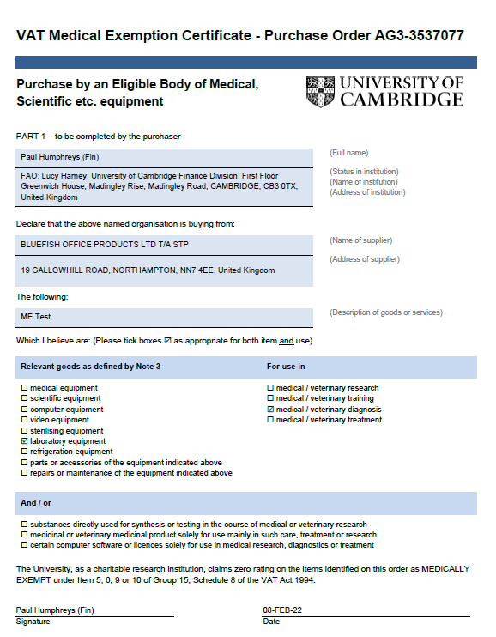
Example of ME Certificate

Slide 37
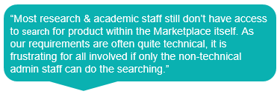
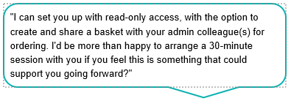
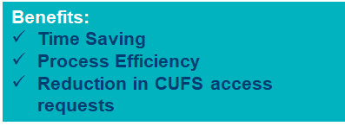
Marketplace Read Only Access
Current Issue
Access to Marketplace is currently via CUFS
Difficult and time consuming to place orders without obtaining CUFS access
Proposed Solution
Read only access accessible via a web link
Access provides full visibility of Marketplace products
Allows users to create a basket and share with admin colleagues to place order on their behalf
Next Steps
Update CUFS new user form to include read only access option
Update new user process to route read only access requests to procurement
Communicate change to wider university

Slide 38
Concur Update
Stephen Kent-Taylor

Slide 39
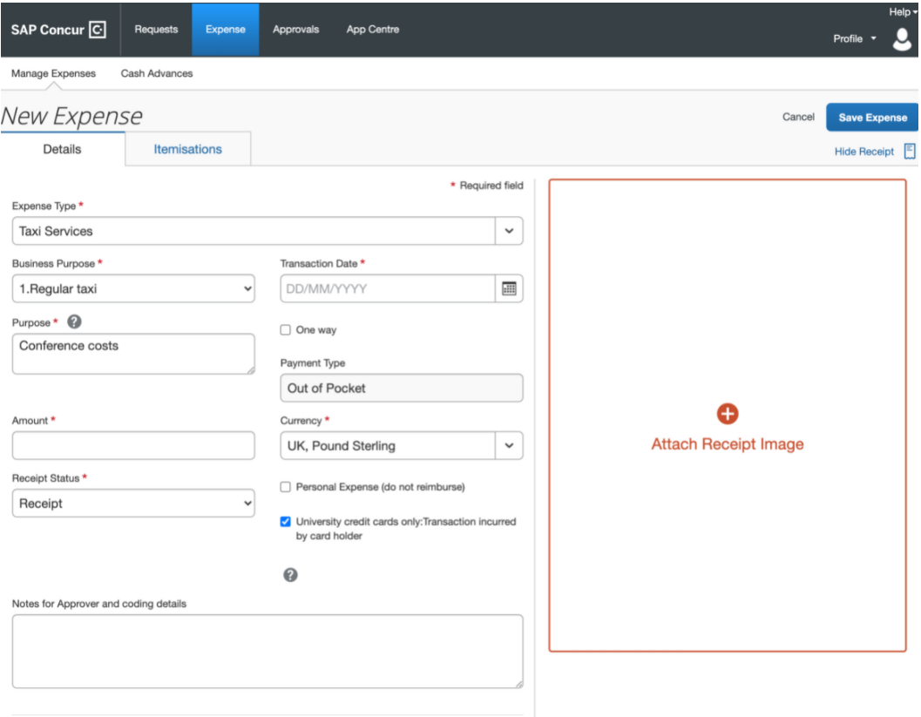
Expenses system - Concur
Rolled out to several departments
Good feedback, currently making improvements
Rollout to continue soon
– update at next FUG

Slide 40

eInvoice Update
2000 eInvoices are 'stuck'
Action being taken by Oracle, Advanced (marketplace) and Financial Systems Group
Expect invoices to be loaded in next 14 days
New invoices loading 'normally'

Slide 41




Please review your list and take action as necessary

Slide 42

Questions and Answers

Slide 43







