Slide 1
A statement from the FUG
Following Chris and Stephen's multiple indiscretions and ill-advised comments, they have been asked to step back from presenting, and our remaining FUG presenters have now boycotted today’s FUG in solidarity.
We regret to inform you that this morning’s FUG will consist only of a slide presentation with no presenters.
We are working to resolve the situation

Slide 2
Financial Users Group
17 March 2023

Slide 3
Agenda
Welcome
Matters arising/action points
Year-end timetable
CUEF purchases and sales
Concur expenses
Finance Division updates
Questions and answers

Slide 4
Year-end timetable
Mike Sinclair

Slide 5
2023 Year End Module Closure
 | FY2023 | FY2022
Year End | Mon 31 Jul | Sun 31 Jul
Shared Services submission deadline | Tue 8 Aug | Mon 8 Aug
Fixed Asset Returns due | Thu 10 Aug | Wed 10 Aug
Close Internal Trading – Raising (AR) | Thu 10 Aug | Wed 10 Aug
Close Internal Trading – Processing (AP) | Tue 15 Aug | Mon 15 Aug
Close AR and AP | Tue 15 Aug | Mon 15 Aug
Close Grants | Thu 17 Aug | Wed 17 Aug
GL Closure for Departments | Wed 30 Aug | Tue 30 Aug
GL Closure for Finance Division | Mon 4 Sep | Fri 2 Sep
Audit start date | Mon 11 Sep* | Mon 12 Sep
Year-end certificates due | Fri 22 Sep | Fri 23 Sep
NB – same number of working days as in previous year
* - TBC

Slide 6
CUEF purchases and sales
Dave Sizer

Slide 7
CUEF Purchase and Sales
Current process – example December 2022
Request made to Treasury by 13th December 2022 to transact
CUEF revalued late March 2023 and purchase / sale transactions input in CUFS March-23
Proposal – example December 2022
Request to Treasury by 13th December 2022
Entry input in January 2023 in CUFS for purchase / sale using September 2022 value
CUEF revalued late March 2023 and actual purchase / sale entries input in CUFS March-23 reversing out January entry
Reasoning
More accurate/timely reflection in departmental accounts
Avoid duplication of requests in consecutive quarters

Slide 8
CUEF Purchase and Sales
Requests are monetary values – early entry will be accurate. Maximum variance will be the value of one unit.
Stat (number of units) will also be updated – will not have as high as level of accuracy if large unit value change / all units requested to be sold.
The proposed changes are planned to commence from April 2023. This will be the March 2023 transactions, using the December 2022 unit value and posted in CUFS in the April 2023 period.
Any Questions?

Slide 9
Concur expenses
Stephen Kent-Taylor

Slide 10
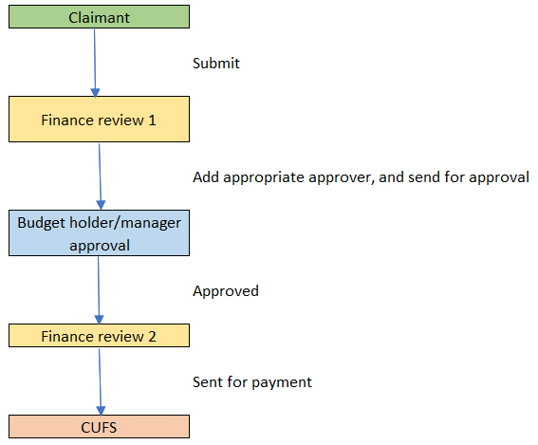
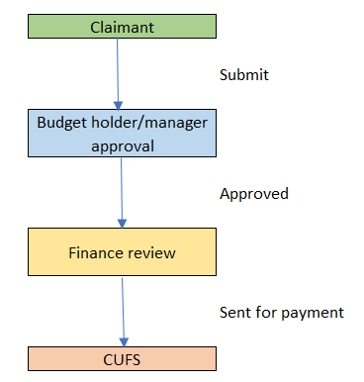
Concur: Finance review - options
Most common set up
Alternative

Slide 11
Concur: Finance review - options
Notes:
The two Finance Teams are separate (with different email addresses). This way you know if a claim is coming for first or second approval.
At first finance review stage, the Finance Team must add the appropriate approver for the claim.
Every staff member in the department has the two finance teams as their default first and second approver.
If you want this set up, please email fsg.system.support@admin.cam.ac.uk

Slide 12
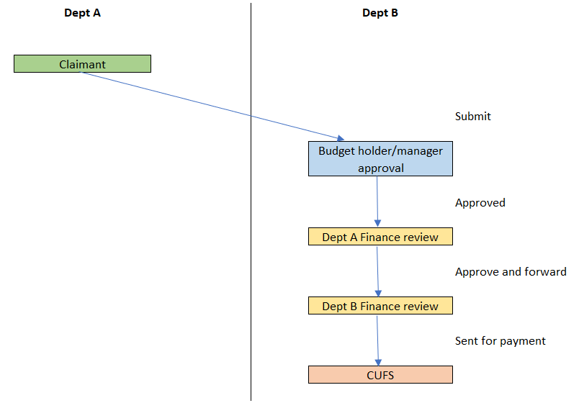
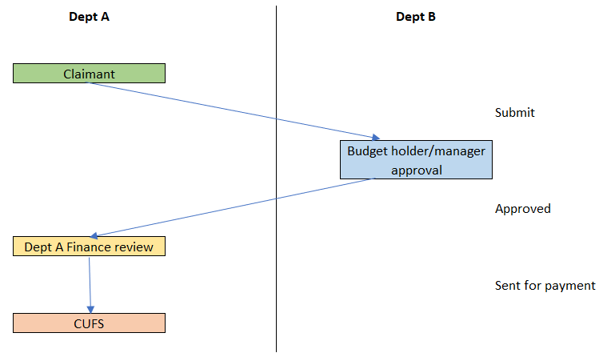
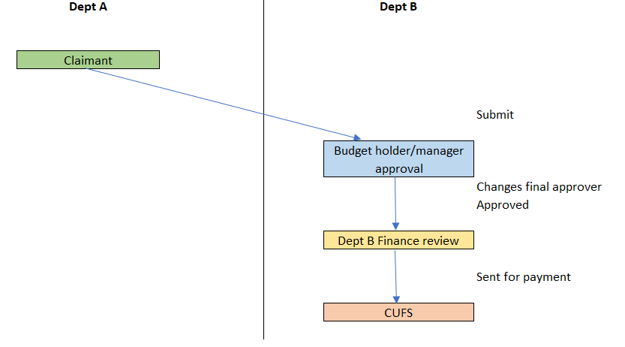
Concur: Claim coded to another department

Slide 13
Concur: Unclassified costs
Can be used if genuinely no suitable option
But please make sure the type of spend is clear
If common types of expenditure don’t have a suitable expense category available let me know.
Aware of: Fieldwork costs (but should use suitable expense types where available)

Slide 14
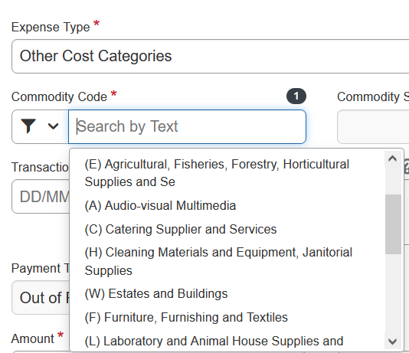
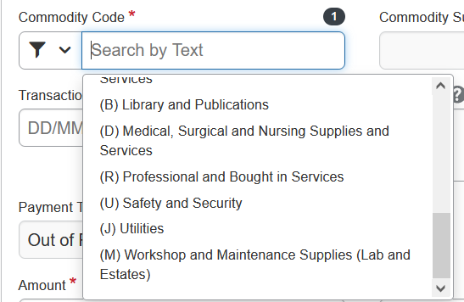
Concur: Unclassified costs
Other cost categories are available!
Approvers can change Expense Types in many cases

Slide 15
Concur: Expense types refresh
Nearly done!
Some unlucky users may have experienced temporary issues when the changes went though
Sorry about this!

Slide 16
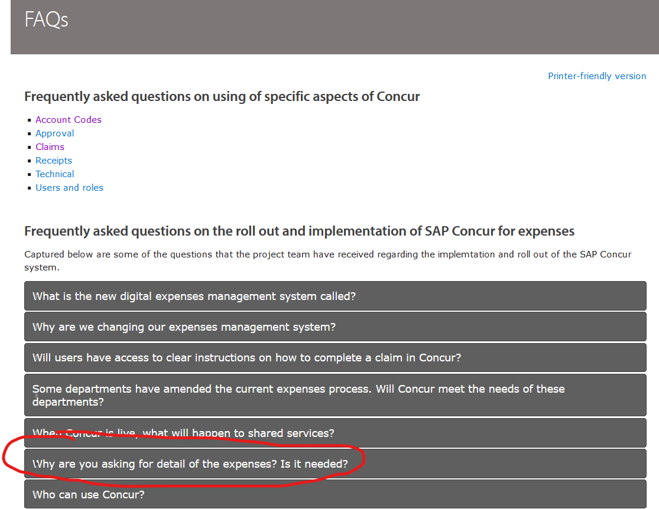
Concur: Why so much information?!

Slide 17
Concur: Why so much information?!
Our aim is to only ask for information that we genuinely need
Tax (need to demonstrate not taxable on claimant)
Sponsor and regulatory requirements
Tracking carbon impact
Giving Procurement visibility of spend
Adherence to and suitability of expense policy and rates
Not: “It’s made a previously-simple process onerous”
Instead: “We’re making the process fit for purpose”

Slide 18
Finance Division Updates

Slide 19
Cognos Upgrade
Why: Annual Security Patching
When: 27 April
Time: 7am to 12 noon
Impact: Cognos will be unavailable at this time. A communication will be issued when access is restored. No changes in functionality and existing reports and views will continue to work as before

Slide 20
Shared Services – suspense grants
Shared Services will code to suspense grants where an invoice can’t be processed due to:
a Funds Check Failure
Invalid coding (eg project/task not active, award/project combination not right)
This makes our processes more consistent, and means supplier payments less likely to be held up while we work out where a cost should be coded to.
Issues relating to purchase order hold will continue as normal and hold up payment.
This makes it even more important that suspense grants are cleared regularly. Cannot use tools/transfer for items which came from AP (including Concur costs). Must amend AP invoice coding. Departments can amend the coding (ideally after payment). We will secondary approve.

Slide 21
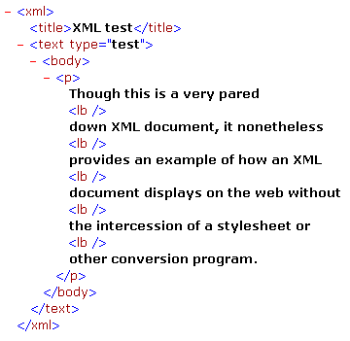
einvoicing – high-value hold
Currently einvoices of £2,000+ go on a high-value hold and need review
This was brought in:
In case ‘track as asset’ needed to be ticked (fixed asset threshold now £5k)
Because, at the time, users weren’t comfortable with high value invoices going in without review
Poll: Are you happy for us to increase the high-value hold threshold from £2,000 to £5,000?

Slide 22
Training updates
Free BUFDG course
www.finance.admin.cam.ac.uk/training
Grants Management in CUFS training review
your feedback welcomed
Accountants Update session Tue 28 March 15:00 –16:30 Teams event – sign up form

Slide 23
Questions and Answers

