Slide 1
General Data Protection Regulation: Changes and Implementation
James Knapton, Information Compliance Officer, Registrary’s Office

Slide 2
Contents
What is the GDPR?
Key changes from the Data Protection Act 1998
How the University is managing its preparations

Slide 3
What is the GDPR?
EU General Data Protection Regulation applies in full from 25 May 2018
Data Protection Act 1998 repealed on same date
Will apply in UK despite and beyond Brexit
Sets standards for handling (‘processing’) of information (‘personal data’) about living identifiable individuals (‘data subjects’) by organisations (‘data controllers’)
Uses existing concepts of data protection principles and data subject rights
Certain types of activity exempt from certain aspects of the standards
More prescriptive and punitive than DPA: Information Commissioner’s Office (ICO) fines up to €20m instead of £500k
Supplemented by new UK Data Protection Bill (published September 2017 to apply by May 2018) that adds additional rules and exemptions

Slide 4
Key changes from DPA: Principles
DPA |  | GDPR
Personal data shall be: |  | Personal data shall be:
Processed fairly and lawfully |  | Processed fairly, lawfully and transparently
Processed only for specified and lawful purposes |  | Processed only for specified, explicit and legitimate purposes
Adequate, relevant and not excessive |  | Adequate, relevant and limited
Accurate |  | Accurate and rectified if inaccurate
Not kept for longer than necessary |  | Not kept for longer than necessary
Processed in accordance with data subjects’ rights |  | Not a principle but covered elsewhere in GDPR
Processed securely |  | Processed securely
Not transferred outside the EEA without adequate protection |  | Not a principle but covered elsewhere in GDPR
Not covered in DPA |  | Data controller must be able to demonstrate compliance with principles

Slide 5
Key changes from DPA: Lawfulness(1)
Under DPA, need to meet a ‘condition for processing’ for personal data use
With consent
To operate a contract
To meet a legal obligation
To protect the data subject’s vital interests
To perform a public interest task
To further the legitimate interests of the data controller
Under GDPR, these are reformulated as ‘legal bases for processing’
Higher standard of consent – freely given, specific, informed, demonstrable
‘Legitimate interests’ invalid for public authorities ‘in the performance of their tasks’

Slide 6
Key changes from DPA: Lawfulness (2)
For ‘special category personal data’ (more sensitive information), need an additional legal basis
With explicit consent
To make/defend legal claims or prevent/detect crime
For medical purposes
For research purposes
And more…
University needs to:
Reconsider its legal basis for each type of data use for each type of data subject (applicants, students, alumni, staff, research participants…)
Realign its engagement mechanisms with different types of data subject

Slide 7
Key changes from DPA: Privacy notices
DPA: need to tell individuals
Who you are
How you’ll use their data
GDPR: need to do this plus
Must cover numerous extra topics, including the legal basis relied upon, retention periods, data sharing, the existence of data subject rights…
Must be transparently worded and accessible
All University privacy notices need to be rewritten and (where possible) rationalised and standardised

Slide 8
Key changes from DPA: Rights
Enhanced rights of:
Access
Rectification of inaccurate personal data
Restriction pending verification or correction
Objection (including to profiling and direct marketing)
New rights of:
Erasure (‘the right to be forgotten’)
Portability
All rights are qualified, and UK’s DP Bill adds numerous specific exemptions
University needs to assess its systems and processes to enable the rights to be fulfilled if exercised

Slide 9
Key changes from DPA: Accountability
New focus in GDPR on accountability measures
Policies and procedures to promote data protection by design and default, including Data Protection Impact Assessments for ‘high risk’ processing
Detailed rules surrounding contracts with joint data controllers and with data processors
Maintenance of a personal data register
Newly prescriptive requirements about security, including reporting certain personal data breaches to ICO within 72 hours
Newly prescribed role of Data Protection Officer
All require new / revised policies, guidance, records, training, ways of working…

Slide 10
Key changes from DPA: Specific research exemptions
Member States can vary rules for data processing for specific activities
Research exemptions under GDPR and UK’s DP Bill
Processing for journalism, art and ‘academic purposes’ exempt from all principles, legal bases, privacy notices and rights
Processing for archiving, statistics and ‘scientific or historical research purposes’ exempt from some principles and some rights, but not legal bases or privacy notices
Accountability requirements still apply

Slide 11
How the University is managing its preparations
GDPR Data Protection Working Group established summer 2016
Chaired by Registrary
Members from Registrary’s Office, LSO, Student Registry, CAO, ESP, UIS, CUDAR, Research Office, HR, UL, OIS, academic departments, CA, CUP
Terms of Reference: “To develop, scrutinise and approve the necessary changes to the University’s policies, procedures, guidelines and training in time for the implementation of the EU’s General Data Protection Regulation. Where formal Committee oversight is required for any particular change, to develop, scrutinise and recommend the necessary change to the relevant Committee.”
Many changes can be implemented centrally
GDPR Toolkit for Institutions for changes that must be implemented locally

Slide 12
Further information
Website (Raven required)
https://www.information-compliance.admin.cam.ac.uk/data-protection/general-data-protection-regulation
Email
data.protection@admin.cam.ac.uk

Slide 13
Finance Systems Update
Michelle Bond and Stef James
Financial Systems Group

Slide 14
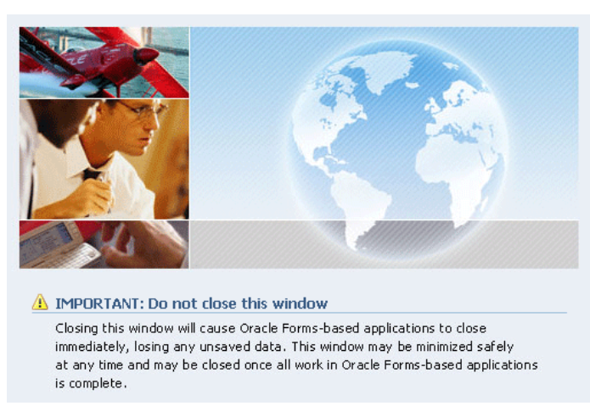
Java Web Start
Currently:
From Monday 5th February
The latest version of Java supported for use with CUFS
v 1.8.0_151
There will no longer be a ‘middle’ window, just this pop up will show and disappear

Slide 15
Planned downtime
CUFS Critical Patching
Downtime Fri 5pm 2nd / Mon 9am 5th February 2018
CUFS Hardware Refresh
Downtime Fri 5pm 27th / Mon 9am 30th April 2018

Slide 16
CUFS Password security
Policy is currently being written to recommend the CUFS password is:-
Password is 13 characters or more
Password is never changed
The length of the password will strengthen security
This is in line with Oracle, NIST and Government security websites.

Slide 17
Library Interface - ALMA
ALMA is the new University Library Management system (old one was Voyager)
Went LIVE on 17th January 2018
Able to now pay for Library fines via one online payment and this automatically updates your account rather than a manual process
Part of a wider Library process and system change

Slide 18
Supplier search and request
Replace and enhance the current supplier database search and request
Dept. users have been invited to a demo of the progress made so far
Anticipated this will be LIVE in the summer

Slide 19
E-Invoicing expansion
PO flip- next 5 suppliers for go live are, Biolegend, Cambridge Bioscience, Insight Bio, Blackwell and Miltenyi Biotec.
A questionnaire will be issued to understand department ordering processes.
The results of this questionnaire will be used to inform next steps and the expansion of e-invoicing.
Look out for the questionnaire, if you specifically have any comments please contact me- Stef James, stefanie.james@admin.cam.ac.uk

Slide 20
Chart of Accounts review- draft notes
A project is currently underway to review the Chart of Accounts.
A questionnaire will be released to key department contacts at the beginning of February.
This questionnaire is looking to investigate whether the Chart of Accounts would benefit from minor tweaks or more prominent changes.

Slide 22
Project Pectus - Intro
Spin-off from FIDF work
Small project team (all Fin Div)
Currently have a pilot in 2017/18 to trial processing ALLOCATION as Income
Cross-section of institutions (c.10) included in the pilot
Possible rollout University-wide for 2018/19

Slide 23
Project Pectus – Intro(2)
Pilot involves operating traditional approach using Budget as well as posting Actual journals
Aims to facilitate reporting and/or monitoring against PLAN consistently regardless of General Ledger SoF (A to L)
Should also simplify part of y/e roll-forward
Requires some Cognos reporting tweaks

Slide 24
Finance Division Update Chris Patten Stephen Kent-Taylor Bernie Parsons
Finance Division

Slide 25
Sort Code Change

Slide 26
Shared Services

Slide 27
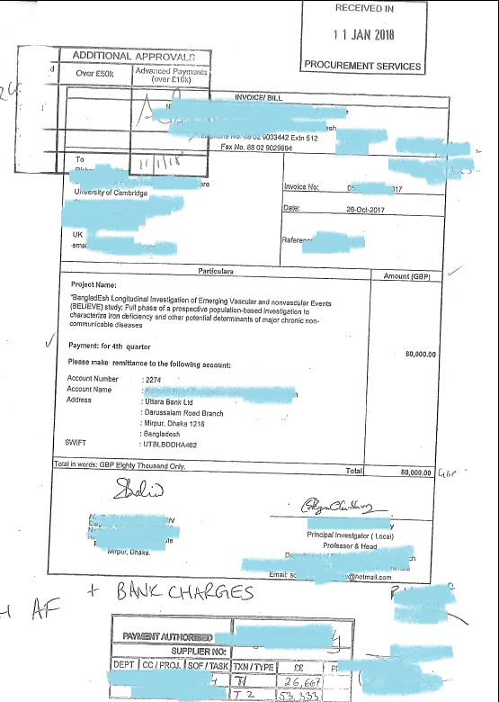
Eternal vigilance…
Notes:
Key points:
Get things in early
22 Dec payment run will include payments up to 4 Jan

Slide 28
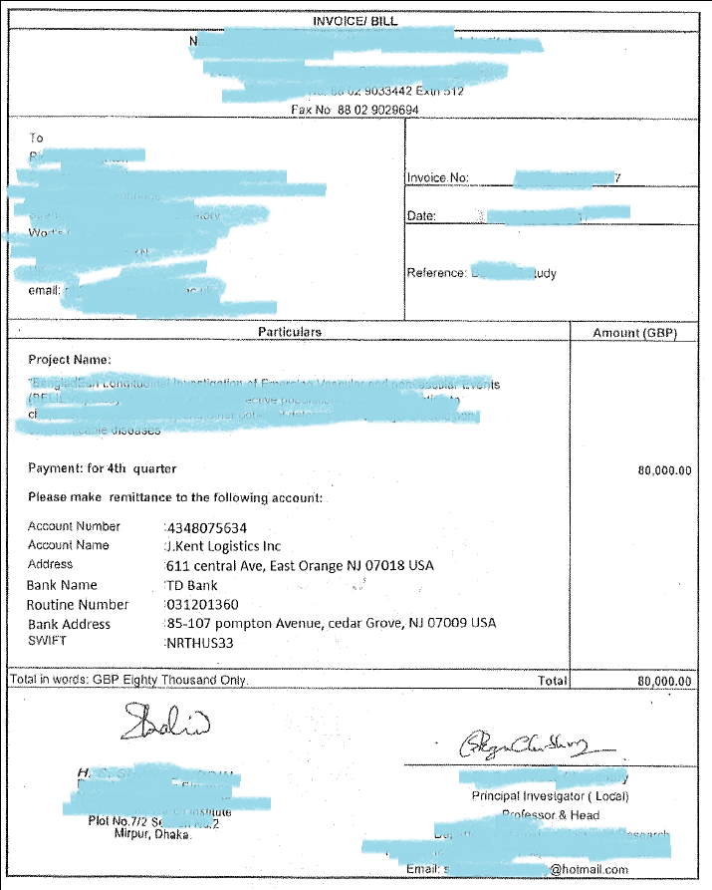
Notes:
Key points:
Get things in early
22 Dec payment run will include payments up to 4 Jan

Slide 29
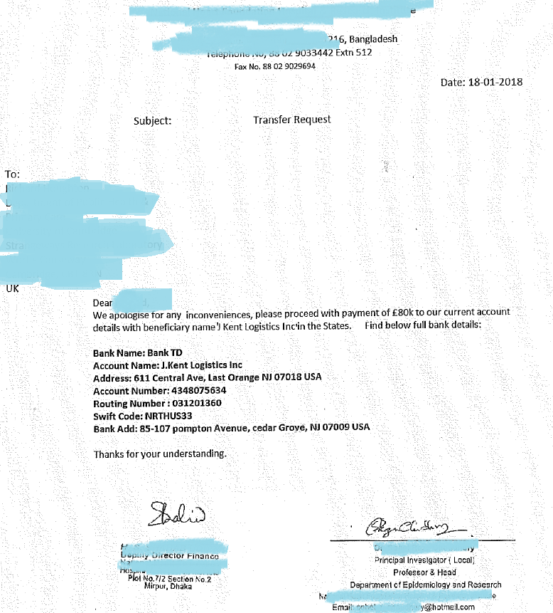

Slide 30
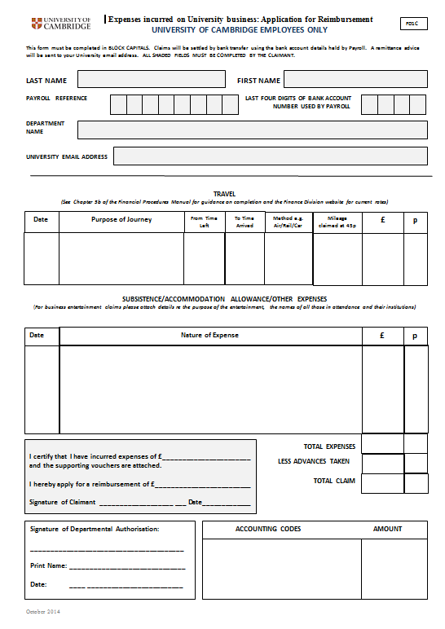
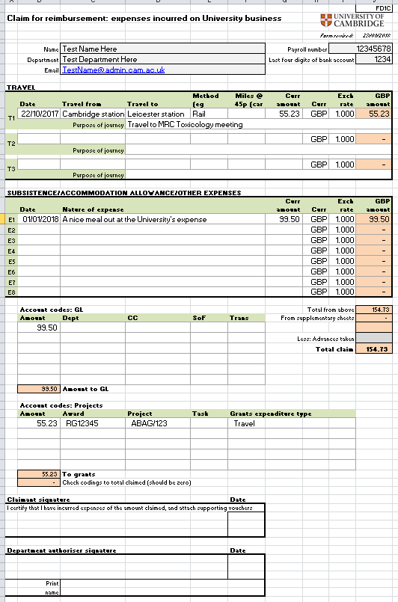
Working on Excel version of expense form(s)
Notes:
Key points:
Get things in early
22 Dec payment run will include payments up to 4 Jan

Slide 31
Questions?

Slide 32
Finance Training Helen Parker Finance Training Helen.Parker@admin.cam.ac.uk
Finance Division

Slide 33
Launching next week
Re-designed for the University in response to your feedback
Less simplistic and includes more relevant University examples
Also includes the two new Corporate Criminal Offences

Slide 34
MRC Toxicology Unit
Joins the University on 1st March – but will remain physically in Leicester for at least a couple of years
Will be part of the School of Biological Sciences
CUFS Department code = PU

Slide 35
Off Payroll Workers video advert
Just 1 minute long
Raises awareness for those involved with hiring in contractors/services
And points them in the direction of more information and help
Currently available from the Streaming Media Service @ https://upload.sms.cam.ac.uk/media/2648700

Slide 36
Coming soon …..
Managing the Budget courses
Register your interest on UTBS
https://www.training.cam.ac.uk/fin/event/2456251
Sharing best practice …
How are you currently using Excel macros?

