Slide 1
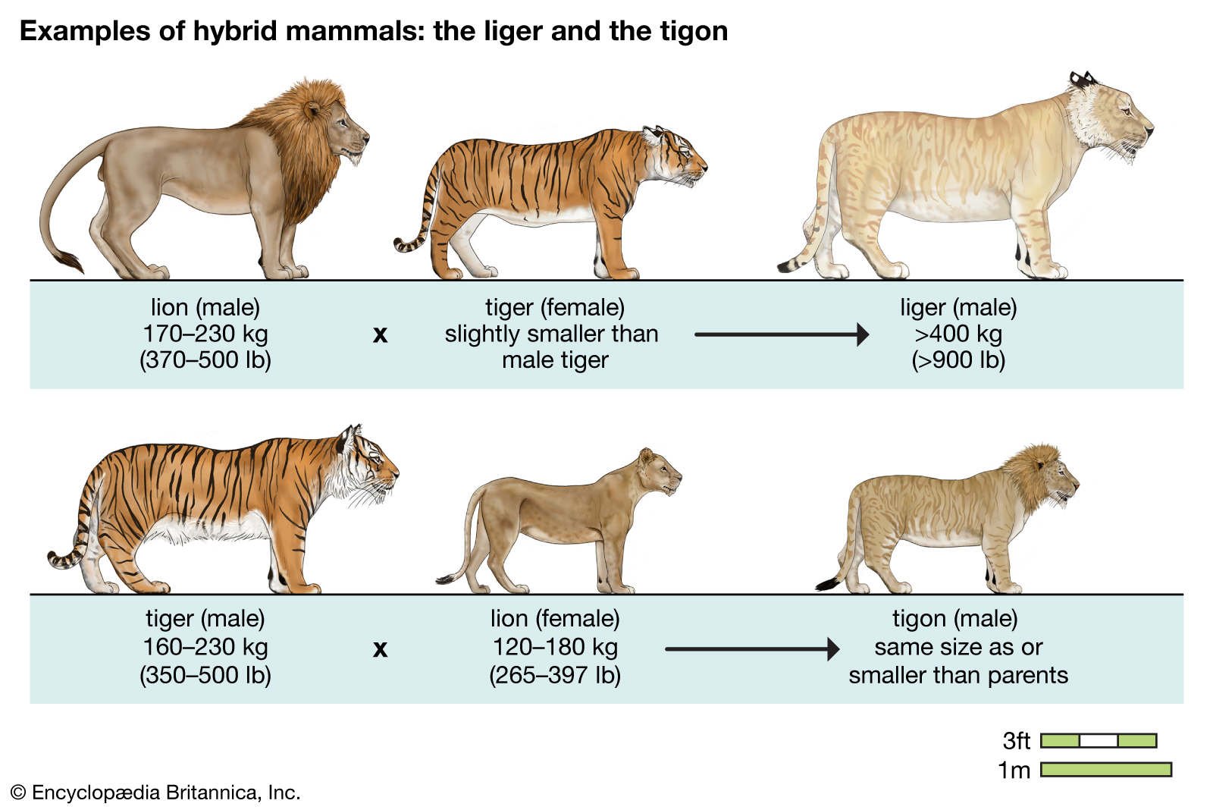
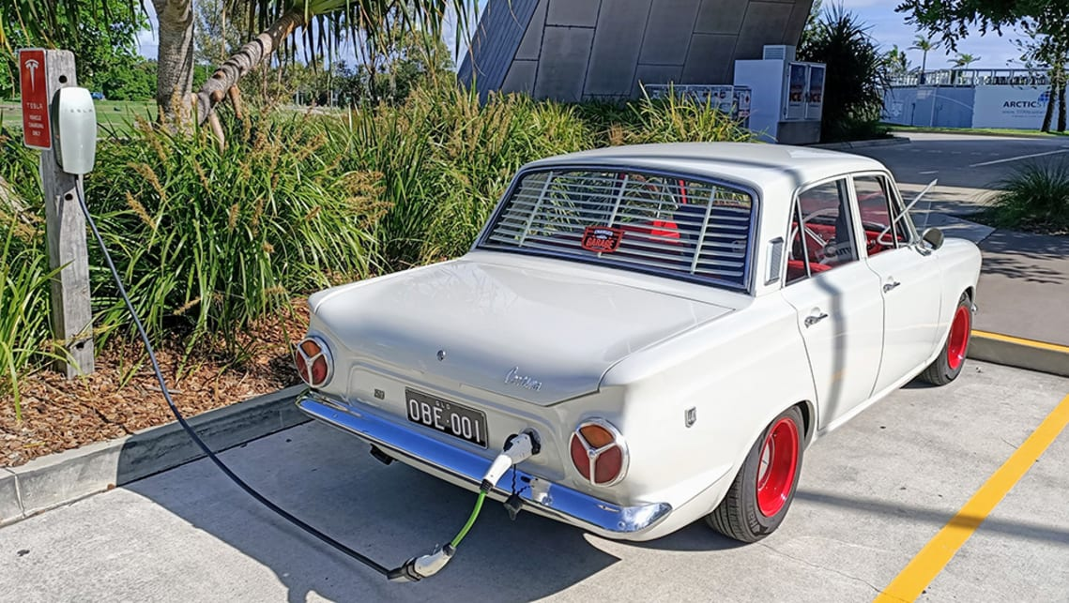
Welcome to the first hybrid FUG!

Slide 2

Welcome to the first hybrid FUG!

Slide 3

Financial Users Group
27 April 2022

Slide 4
Agenda
Welcome
Matters arising/action points
Travel update from Procurement
Finance Division updates
Questions and Answers

Slide 5
Travel Management Company (TMC)
Contract Update
Chris Quilter – Contract Manager
Chris Goody – Strategic Sourcing Category Manager

Slide 6
Contract Management Update - BAU
Travel spend is recovering quickly
Physics and Engineering are the biggest spenders this financial year so far
The industry as a whole has been struggling with demand – long delays at airports, back office staff not available etc.
Global events continue to impact on service – many enquiries resulting in longer delays
Total monthly spend with Key Travel

Slide 7
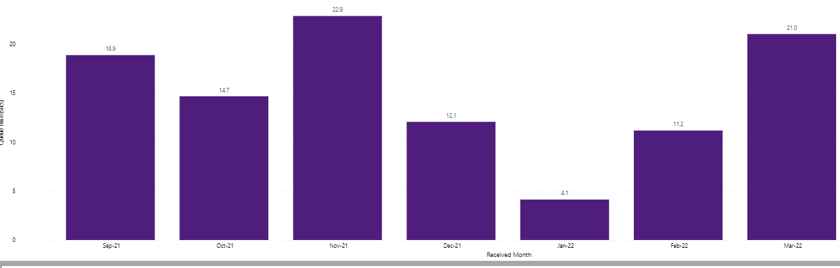
Contract Management Update – Enquiry Delays
What we heard
Delays whilst contacting Key Travel by phone
Delays in responding to emails
Average call waiting time (Minutes)
TrainLine online ticket failure
Unprecedented volume increase
B.A., systems failure and mass cancellations from airlines
Early return to travel
Key resource increase begins to take effect
24th February, Ukraine war begins

Slide 8
Contract Management Update – Enquiry Delays
The response
Key Travel have reviewed the current operating model
Since 4th April - a dedicated team of agents have been assigned for the University of Cambridge enquiries
Key Travel have committed to an ongoing review of dedicated staff to support the University as travel recovers
The outcome
Performance has improved significantly:
  Average call waiting times for April to date have reduced to 16 minutes (24% reduction on March)
  Average call waiting times since 4th April have reduced to 2.5 minutes
  Average response time for responding to emails is remaining steady at 3.83 working hours
How to contact Key Travel
Online – https://my.keytravel.com/uk
General bookings - 0161 819 9769 or cambridge@keytravel.com
Group bookings - 0161 819 8935 or groups@keytravel.com

Slide 9
New Contract - Procurement
Context - Supplier
Key Travel have been the University Travel provider for 16 years
Most recent dispensation to continue to use Key Travel expires in November ‘22
Context - Procurement
  SPP Programme now stood up therefore resource to re-procure and, actively, Contract Manage
  Logical to re-engage the market to re-procure

Slide 10
New Contract - Procurement
Market Development
Market has shrunk considerably since Covid challenges
Some suppliers have gone under, others have reduced staff
Market anticipating approximately 70% of pre-Covid requirement
Opportunity to…
Identify a committed travel partner that is eager and contractually motivated to support us in, at least:
  * Flights
  * Rail
  * Hotels
  and…..

Slide 11
New Contract - Procurement
Apply University process/diligence around pre-travel checks and requirements. Example only:
TMC system requires assurance that booker has satisfied UCAM:
Risk Assessment
Insurance requirement
?
UCAM system kicks in requiring assurance, from booker/traveller within x days of travel
Yes – proceed to booking
Book in TMC system
No – can progress to booking

Slide 12
New Contract - Procurement
Next Steps:
Working Group set-up. Meeting fortnightly. New attendees welcome
Suppliers met, market engagement ongoing
Development of:
  University priorities, integration into new process flow
  Strategy
  Procurement docs

Slide 13
New Contract - Procurement
?

Slide 14
Finance Division Updates

Slide 15
Indian Equalisation Levy
(Digital Sales Tax):
A request for data for tax returns
Matt Hodgson – Head of Group Tax

Slide 16
BACKGROUND
Many countries are introducing digital sales taxes as a response to the global phenomenon of the transition to ecommerce.
India’s version is called an “Equalisation Levy” and it applies a 2% tax on the value of relevant transactions
Relevant transactions are those where:
  An “ecommerce operator”…
  Makes “ecommerce supplies or services” …
  To “a person resident in India or a person buying goods or services using an Indian IP address”
  Continues on next slide...

Slide 17
BACKGROUND
Doesn’t apply to sales made through third party platforms
Quarterly returns and payments – we using estimated figures for Q1-Q3 and truing up for the FY. The Equalisation Levy is currently being paid from the central Chest allocation

Slide 18

A request from the Tax Team
The Tax Team need your data on sales your department has made where:
  The sales have been made online through one of our proprietary platforms; and
  To the best of your knowledge, the purchaser was resident in India, or the IP address of the purchaser was Indian.
Data should cover 1 April – 31 March (not our financial year); the current request is for 1 April 2021 – 31 March 2022 but this will be an annual requirement
An email will be sent following FUG requesting the data.
If you have no relevant transactions you will be asked to confirm a
nil return.
Thank you.

Slide 19
Finance Division Updates
Stephen Kent-Taylor – Head of Corporate and Shared Services

Slide 20

Sanctions
Financial – persons, organisations, banks/payment systems
UK list https://www.gov.uk/government/publications/financial-sanctions-consolidated-list-of-targets
Trade - different for exports and imports, sometimes possible with a licence
  Exports inc. technology transfers - ROO Export Controls Team
  https://www.research-operations.admin.cam.ac.uk/policies/export-control
  Imports – check with the Import Export Hub at Importexporthub@admin.cam.ac.uk
Triage Group – for more guidance and support
  contact the UFS Helpdesk in the first instance UFS_enquiries@admin.cam.ac.uk.
*** Depts will also need to consider reputational risk

Slide 21

Shared Services reminders
Common issues which lead to delays with SSF processing
Receipting of purchase orders
Many invoices held up because of POs not receipted
When goods/services are received – not just when invoice is received!
Non-Clinical School depts – please ensure POs are receipted before sending
invoices for processing.
Clinical School depts – essential to have robust processes for receipting, since invoices go directly to SSF

Slide 22
Shared Services reminders
Expense claims
Make sure forms are correctly completed
If individual doesn't have supplier on AP, write NEW in supplier # box
Ensure it's clear if claimant is:
a) an existing student – quote USN
b) an employee – quote payroll ref
c) other individual – give full name and suppler number if on CUFS (include supplier
name if abbreviated)

Slide 23
Shared Services reminders
IPOs (international payments)
Only GBP payments to UK bank accounts are NOT IPOs. Everything else is.
- send through each IPO request in a separate email – do not batch them with
non IPOs, and ideally don't send IPO requests for more than one supplier in
the same email.
- multiple IPOs for a single supplier can go in the same email
- indicate which bank charges the department is paying (if using form for
non-standard IPOs)
(Bank charges are charged to the same coding as the invoice, up to a month later)
If sending to SSF to process on to CUFS, please only send to the main inbox sharedservicesfinance and do not copy in IPO@admin as this could lead to duplications

Slide 24
Shared Services reminders
Coding
Grants – info required for coding
Please provide:
- project
- task (will assume task 1 if not present)
- expenditure type (will assume Other Cost/Misc if not present)
GL transaction codes
Please provide transaction code where known. If transaction code not known,
please indicate nature of spend if not clear on invoice/documentation

Slide 25
Shared Services reminders
Emails with SSF – helping us work faster and smarter
Please always put your two-character department code at the start of
your email subject line
This will help us route your email to the right pod quickly.
If genuinely urgent, please type URGENT as the next bit of the subject line.
(And don't over-use urgent please!)
Attachments on queries
When SSF send you a query with (say) an invoice attached, please use FORWARD rather than Reply/Reply All when responding, as this will keep the attachment on the email.
(Forward to sharedservicesfinance@admin.cam.ac.uk)

Slide 26

AR and Credit Control reminders
The Finance Credit Control team can run credit checks on new customers
(NB Not on individuals)
Please remember
Only give credit where appropriate (eg get payment in advance for venue hire)
Raise sales invoices promptly (it's much easier to collect a recent debt)
Chase debts when they fall due
AR portals: please contact Credit Control in the Finance Division if you're asked to use a portal to enter/upload AR invoices to a customer.

Slide 27
Accounts payable reminders
AP invoices
Ensure POs are correctly coded and receipted
Get invoices onto CUFS/ to Shared Services promptly
Supplier Statements
Make sure these are reviewed
Follow up any queries
Credit Notes
Manage your credit notes – process them and ensure netted off against future payments

Slide 28

Internal audit points
Document Retention:
Keep documents for the appropriate amount of time
In a secure location, with appropriate access
Same principles for physical and electronic documents
Delegation of Authority
Template available (FPM ch20, appendix B)
Include your expense sign off limits

Slide 29

Segregation of duties
Purchase to Pay (iProc to Accounts Payable)
Try to separate out the parts of the process
•Those Requesting the good (works or services)
•Those Placing the order
•Those Receipting the goods (Physically in the Stores / Those entering the receipt on CUFS)
•Those Approving the Suppliers Invoice
•Those Processing the invoice in CUFS (This is typically Shared Services)

Slide 30
Segregation of duties
Accounts Receivable (Sales Invoices, Credit Notes and Receipting of 'cash')
Try to separate out the parts of the process
•Those Requesting the Sales invoice to be raised (including calculating the charge)
•Those Raising the Sales Invoice on CUFS (Remember to retain the calculations / details)
•Those Receipting the payment made by the customer – very important if it cash or cheque
•Those Approving a Credit Note to be raised (due to an error / correction)
•Those Processing the Credit Note in CUFS

Slide 31
Segregation of duties
Credit Card Administration (Review, Approval of expense
claims, posting of transactions to CUFS, journals or Concur)
Try to separate out the parts of the process
•Those Holding a Card
•Those Making the transaction online or in person – Remember to retain
receipt
•Those Reviewing the receipts
•Those Approving the actual transactions – Needs to be line manager (or higher) of the card holder
•Those Processing the details into CUFS

Slide 32
Segregation of duties
Applies to all areas (AP, GL, Purchasing, etc)
Don't expose yourself to accusations of wrongdoing
Not always possible in a small department: In these
cases, the department should design their own process
and adequate controls. Then very important to document and communicate the details.
Always need a monthly review of grants, and GL transactions/balances

Slide 33
Concur Expenses

Slide 34
Concur Changes to Categories
Concur will be unavailable on 28th April to allow changes to Expenses type:
‘Miscellaneous Expense type’ is no longer available and is replaced by ‘Other Cost Categories’
The list of commodity codes available under the new expense type ‘Other Cost Categories’ will be significantly reduced.
New expense type called ‘Unclassified Costs, mapped to EXZZ for GL codes, Other Costs/Miscellaneous for Research Grants and Special Items for Estate projects.
Please refer to the Expenses hub webpage for a timeline of what action is required and by whom. If you have any queries, please contact expensesproject@admin.cam.ac.uk

Slide 35


Concur Rollout
Concur Rollout to institutions is proceeding smoothly
Phase 1 Users Roadshow has taken place this week
Meetings with Phase 2 Key Contacts have begun
To find out when your institution is going live, please visit
https://www.expenses.admin.cam.ac.uk/
→ Log in with Raven → Using Concur → On boarding information

Slide 36
Systems Updates
Michelle Bond

Slide 37
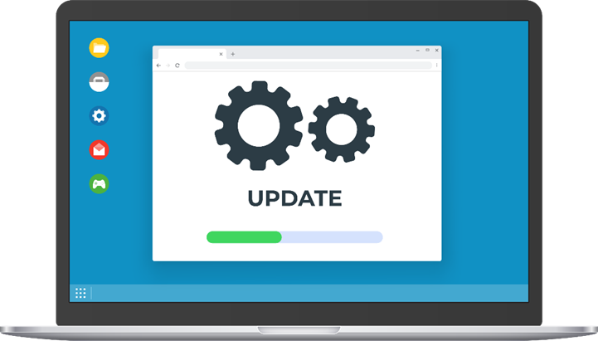
CUFS Patching
Applying latest database and security patches
System downtime starting 1pm on Friday 20th May
System restored 8am on Monday 23rd May
Some issue fixes will be released with patching:
Performance improvement to supplier searches
Discarded lines will once again default to open GL date closest to invoice date
Please put any requests scheduled to run during downtime on hold

Slide 38
FSR Volunteers
The Financial Systems Replacement Project is in need of more volunteers to ensure that the whole University is widely represented…

Slide 39

Questions and Answers

Slide 40








Happy Ending
Back Together

