Slide 1
Financial User Group Wednesday 6th March

Slide 2
Agenda
Minutes of previous meeting
Matters arising / action points
OurCambridge
Finance Systems Update
General Finance Matters
AOB

Slide 3
Finance Systems Update
Financial Systems
Jo Hall
Head of Financial Systems
jo.hall@admin.cam.ac.uk

Slide 4
Data cleansing – Chart of Accounts

Slide 5
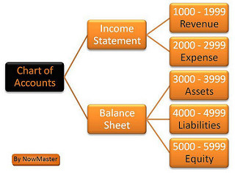
COA Analysis from 1st Aug 2017
Cost Centres
34,871 active
21,560 with no balance (61.83%)
19,159 not used in last 2yrs (54.94%)
18,069 active, no balance and not used (51.82%)
Source of Funds
2,962 active
970 with no balance (32.75%)
686 not used in last 2yrs (23.16%)
673 active, no balance and not used (22.72%)

Slide 6
COA Analysis from 1st Aug 2017
Transaction codes
4,166 active
1,712 with no balance (41.09%)
1,335 not used in last 2yrs (32.05%)
1,303 active, no balance and not used (31.28%)

Slide 7
COA Cleansing
Why?
Cluttered with many codes now not used
Poor usability
Errors
Reporting
Patching / upgrade issues
Action:
Analysis of all segments during March
Review of Inherit Segment Value programme to clear code combinations
Departments notified of the findings and codes identified for closure

Slide 8
Work in progress
Email address on POs – Live by the end of March
Audit – User responsibility listing can be run anytime not just for the 6 monthly audit purpose – propose to burst this out on a monthly basis?
Suppliers (SSR) Phase 2 – volunteers required for user group to inform changes, please contact Rebecca.Darlow@admin.cam.ac.uk

Slide 9
General Finance Matters
Chris Patten and Stephen Kent Taylor

Slide 10
Procurement Services Update March 2019 Jen Waterfield
Team Structure and new appointments
Brexit planning
Stakeholder engagement
Marketplace

Slide 11
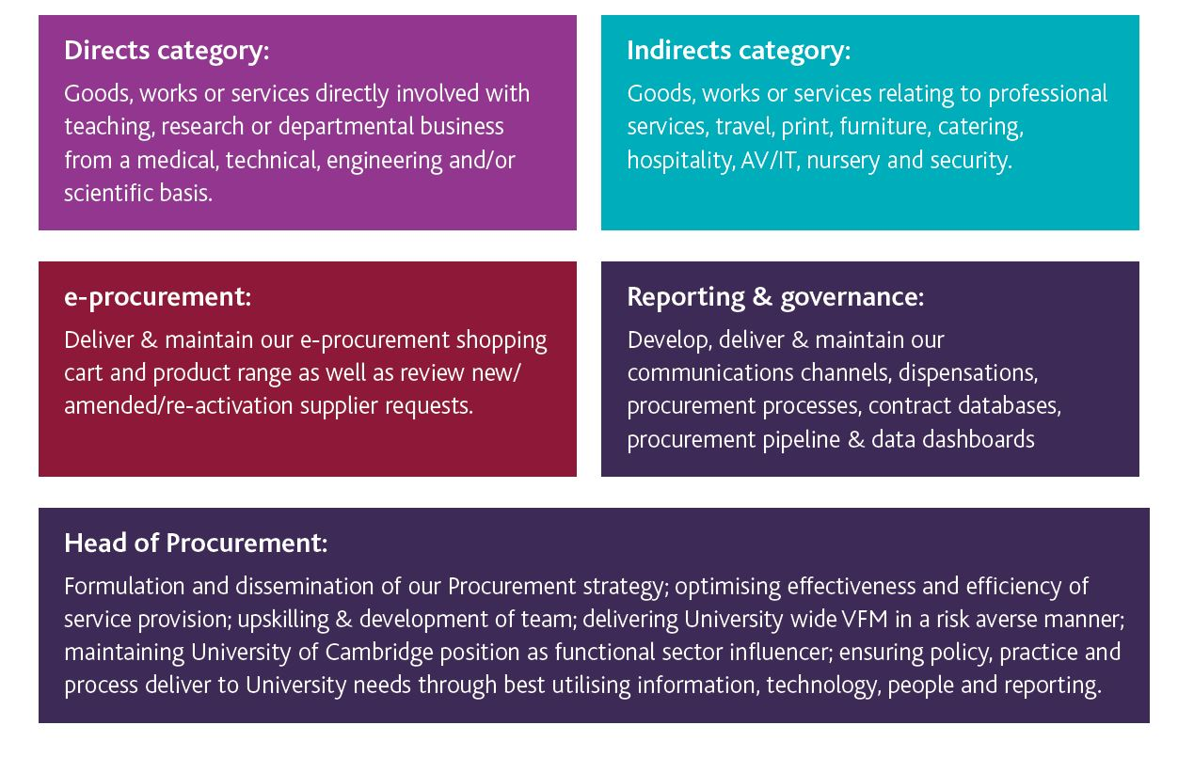
Procurement Team Structure

Slide 12
Internal trading and Barclaycard
Internal invoices – burst to recipient overnight
TES invoices – now with detail on the invoice, with no attachment needed. One invoice per TES worker
Barclaycard – from this month: one invoice per department, one line per card, visible in AP to departments.
You can continue to move costs using GL/Grants journals, or you can move them in AP

Slide 13
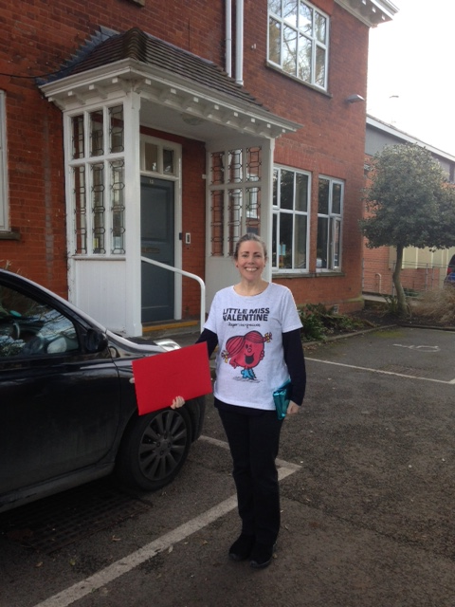
Still delivering some things manually

