Slide 1
Financial Users Group 24 January 2020

Slide 2
Agenda
Welcome
Minutes of previous meeting – Daniel Benham
Matters arising/action points – Daniel Benham
Insurance – Nicky Routh
Finance Transformation Programme – John Galvin
Financial Systems – Paul Humphreys
ourcambridge – Stephen Kent-Taylor
General Finance Matters – Chris Patten
AOB

Slide 3
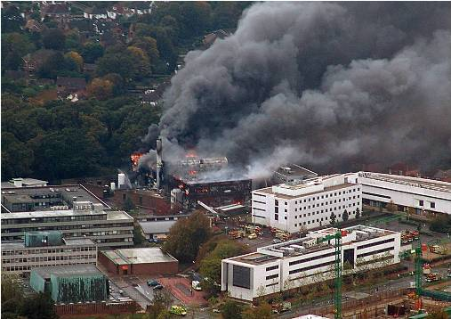
Insurance and Risk https://www.insurance.admin.cam.ac.uk
Southampton University research centre blaze – world-class facility destroyed
Nicky Routh – Head of Group Insurance
Notes:
3
3

Slide 4
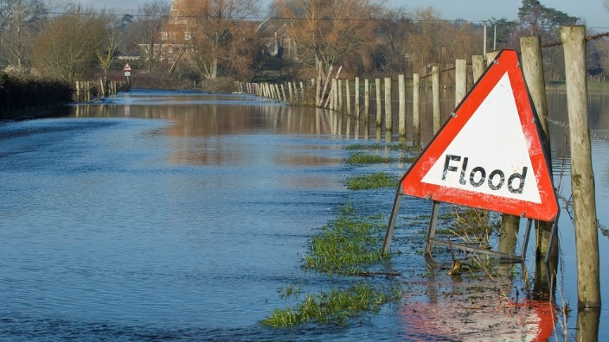
Known knowns
Providers of higher or further education
Research establishments
Property owners
Investors
Research work with aircraft, aerial devices and satellites
Nuclear
Medical Research
Educate graduates to meet UK and global demand for higher level skills
Generate world-class research that transforms lives
Drive innovation that supports local and national economic growth
https://www.universitiesuk.ac.uk/facts-and-stats/Documents/university-spending-explained-summary.pdf
Loughborough University – 2015
Natural disaster

Slide 5
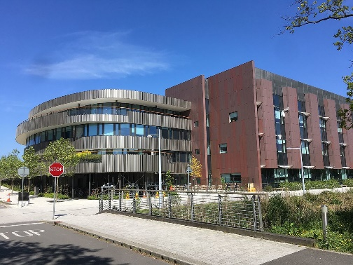
Known Unknowns
Insured Perils - Insurers Definition:-
Fire, Lightning, Explosion & Aircraft, “Dry” Perils, “Wet” Perils
Universities Definition:-
Increased threats to reputation, severe budgetary pressures, threats to research and research funding, rising operational costs, security concerns, duty of care requirements, student complaints, student fees, student retention, spurious claims, legislative requirements, internationalisation, academic risk, risk management, unlimited liability contracts, bed bugs, contract managements, spin off companies, claims defensibility, phase 1 clinical trials, increased threats to reputation
Chemical Engineering Building –2016 new facility
Burst pipes

Slide 6
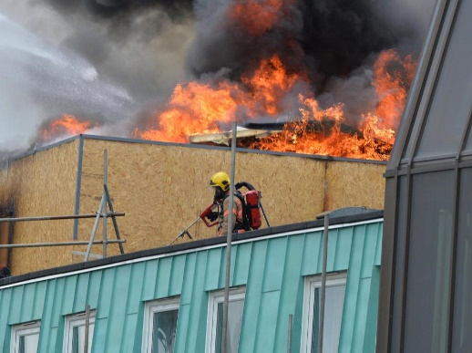
Unknown Unknowns
“Universities are renowned for their tolerance of unusual characters, especially if they show originality and dedication to their research. I have often made the comment that not only are universities a 'cathedral' for worship of knowledge, they are also 'sheltered workshops' for the socially challenged.” ― Tony Attwood, The Complete Guide to Asperger's Syndrome
University of Manchester - Fire at Christie Hospital
was started by welding works in the roof

Slide 7
Any questions?

Slide 8
Finance Transformation Programme (FTP) Discovery Phase Feedback Presentation to FUG John Galvin, interim Head of FTP 24th January 2020

Slide 9
How have we engaged with the University?

Slide 10
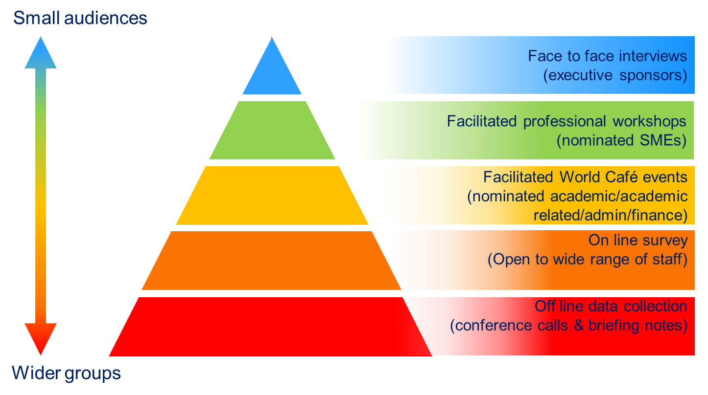
Stakeholder Engagement
A range of stakeholder engagement events were organised to collect comprehensive feedback and identify major challenges, pain points and risks across the University within Finance
Engagement types
 | 308 attendees across all events
 | 5 world café events with 125 attendees
 | 30 process workshops attended by 133 people
 | 43 face-to-face interviews
 | 2 senior management team workshops
 | 1161 survey responses across 94 departments

Slide 11
Internal Communications and Two-Way Engagement
Website for further information about FTP and its key projects
News and updates about the programme and key projects regularly posted to the site
Creation of FTP Yammer group
Communications planner across the FTP programme and key projects
Have your say on the future of Finance!
Two-way engagement is key. We have listed anticipated FAQs
Employees encouraged to submit any queries via FTP mailbox on the website or email:
ftprogramme@admin.cam.ac.uk
Targeting the University's internal communications channels including the staff website, Finance intranet, ourcambridge, Knowledge Bites and Yammer
Yammer

Slide 12
Summary of Findings

Slide 13
FINDINGS FROM analysis (1)
Finance Processes are not user friendly
Limited ability to set financial targets and KPIs
.
End users
No KPIs
Process variations leading to inconsistent ways of working
Chart of Accounts structure is complex leading to risks and mistrust of information
Process variations
Complex Chart of Accounts
Process variations
PROCESS AND PERFORMANCE
Fragmented processes
Reporting
Reporting
Budgeting / Forecasting is manual, time intensive and not aligned
Chart of Accounts mapping can be difficult to analyse.
Manually intensive
Sub-optimal
Processes
Manually intensive processes
Lack of process optimisation across the end to end finance user journey

Slide 14
FINDINGS FROM analysis (2)
Extensive staff knowledge aids overcoming inconsistent processes
Key Person Dependency posing operational resiliency risks
Finance Knowledge
Operational Resilience
Risks
Financial organisation silos lead to duplication of processing and lack of visibility between schools/departments
Multiple financial systems which are not integrated and cause duplication of effort
Org Structure
silos
Complex Systems
Landscape
Org structure Silos
TECHNOLOGY, TOOLS, PEOPLE AND ORGANISATION
Best Practice
Complex reporting processes
Complex
Reporting
Process
Limited best practice sharing and inhibited continuous improvement
Bespoke reporting which hinders decision making.
Complex decision making
Opaque Finance Activities
Complex and devolved structure limits quick decision making
Lack of full visibility of finance activities across the University

Slide 15
Summary of survey comments by key themes
Percentage breakdown of comments relating to the five key themes
1%
Governance and control
17%
15%
People and organisation
Management information, data and reporting
26%
Systems and tools
41%
Processes and policies
The highest percentage of responses were focused upon processes and policies with over a third of all responses alluding to this theme. Comments were broadly around inefficiency, lack of transparency and manual effort being required.
Systems and tools were also readily discussed. Systems were described as unintuitive, outdated and time consuming to manage.

Slide 16
As-Is Operating Model: High Level Capability Assessment
The finance capabilities below were assessed by looking at system, process and people perspectives. Overall, they can be largely improved
ADHERENCE TO GOOD PRACTICE:
High
Medium
Low
Absent
Accounts payable
Accounts receivable
Cash management
GL / CoA
Pensions
Payroll (Inc. off payroll)
Credit cards
Expenses management
Credit control
Customer setup / maintenance
Direct debit collections
Bank reconciliation
Creating and posting journals
Maintain pension records
Pay employees
International payments
Process invoices
Invoicing (internal & external)
Bad debt and write-offs
Petty cash
GL maintenance
Administer pension schemes
Invoice payments
Refunds
Receipting
Sales - online,
EPOS, other systems
Reporting on pensions
Overtime
Fixed Assets
Treasury
Supplier setup / maintenance
Research grants
Register / capitalise asset
Cash monitoring / forecasting
Budgeting and forecasting
Starters, leavers and changes to pay
PAS / Estates
Costing grant applications
Contract and Pre-Award
Asset tagging
Currency trading and hedging
School and dept. budgeting
Chest allocation
Off payroll workers
Commercial property income
Capital projects
Budget and set up grant
Administer and close grants
Asset verification
Administer Endowments
Admin funds budget & forecasting
Calculate net pay
Residential income
Tenancy deposit accounting
Tax
Asset adjustments
Administer internal loans & shared equity
Setting course fees
Capital planning
Auto enrolment
Donations
Helpdesk
Compliance
P11D
Bond accounting
Insurance
Log and respond to query / issue
Payroll reconciliations
Receiving donations
Corporation tax
International tax
Reporting
Claims handling
Management and review
Processing donations
VAT
Reporting to funding bodies
Month-end reporting
Audit
System Admin
Policy / Guidance
Coordinate external and internal audits
Reporting donations
Maintain / upgrade systems
Inventory
Trust fund statements
Annual financial statements
Setting policy
Maintain financial procedures
Overheads
Fin. Training
Identification and stock take
Manage
inventory
Bespoke / ad-hoc internal reporting
Capital reporting
Strategy
Master Data Management
Research grant overheads
Train staff
Issuing/ Returning
Statutory reporting
Financial modelling
Define Finance strategy
Manage functional performance
Continuous Improvement
ICC
Vocational and professional training
Portfolio Management

Slide 17
Next Steps
Notes:
Survey – a lot of people engaged

Slide 18
Pre-Approval Phase Work Streams
Communications (Nicola Lawrence)
Reporting (Joanna Walmsley)
Process improvements (Stephen Kent-Taylor)
Organisational alignment/Change management (Louise Vincent)
Finance systems (Michelle Bond)
Performance improvement (Chris Patten)
General ledger (Mike Sinclair)
Master data management (TBD)

Slide 19
CUFS User Review – AP, AR, GL, and Fixed Assets Financial Users Group
Paul Humphreys
Notes:
19
19

Slide 20
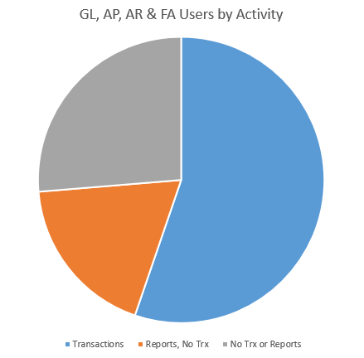
CUFS User Review
Focus on AP, AR, GL, and Fixed Assets
iProcurement and Grants not covered
Reviewed CUFS usage between 1st August 2019 and 2nd January 2020
55% of users process transactions
19% of users only run reports
26% of users do neither
Review in progress with School Finance teams

Slide 21
CUFS User Review
Infrequent users need the most support
Using CUFS may not be the best solution for infrequent users
Looking for most cost effective future licence agreements
Next Steps:
Remove access from those who do not process transactions or run reports – those affected will be contacted
Work with School Finance teams to provide support
New guidance for Departmental Key Contacts to determine most suitable access for new users

Slide 22
ourcambridge and Finance Update Financial Users Group 24 January 2020
Stephen Kent-Taylor and Chris Patten
Notes:
22
22

Slide 23
What is it?
ourcambridge is the programme asking
staff to submit ideas to help
improve the University:
Supporting our staff
Ways of working
Simplifying our processes
Started off with launch events and then workshops
Staff can submit ideas online:
ourcambridge@admin.cam.ac.uk
https://www.ourcambridge.admin.cam.ac.uk/submit-idea

Slide 24
AR customer sites (i.e. addresses)
Cleanse:
From 32,000 non-research customer sites in July, we are now down to around 9,000 sites across 7,000 customers.
Some of the 9,000 site will be duplicates.

Slide 25
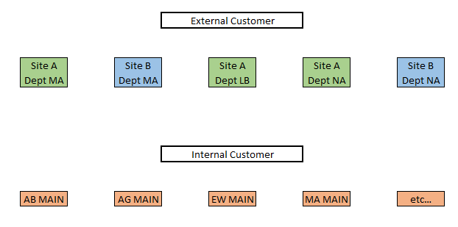
AR customer sites (i.e. addresses)
Currently:

Slide 26
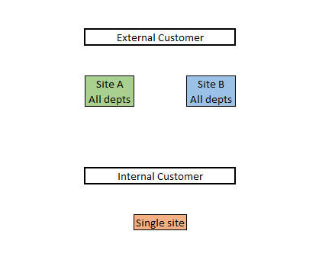
AR customer sites (i.e. addresses)
From next Tuesday (28 Jan):

Slide 27
AR customer sites (i.e. addresses)
Benefits of making sites usable to all departments:
Reduce duplication
Reduce maintenance
Reduce numbers of set ups
Increase consistency
Internal customer set up and maintenance will benefit a lot
A lot of data cleanse has already been done. Once the change goes live more data cleanse will be needed.
You may see multiple duplicate sites on a customer initially.

Slide 28
AR customer set up
Central AR customer set up service has been running for several years, with quick turnaround.
This has helped ensure consistency of customer records.
With the sites simplification, we are now making the service mandatory in almost all cases.
A small number of departments have been identified who will retain limited ability to set up customers.
ALL site (address) amendments will be done centrally.
Remember: you can use eSales (e.g. for individuals and payments up front). No need to set up a customer or raise an invoice!

Slide 29
AR screen clean up
You may soon notice some changes to the AR Transactions screens.
We’ve done a light touch clean up – removing some unused fields.

Slide 30
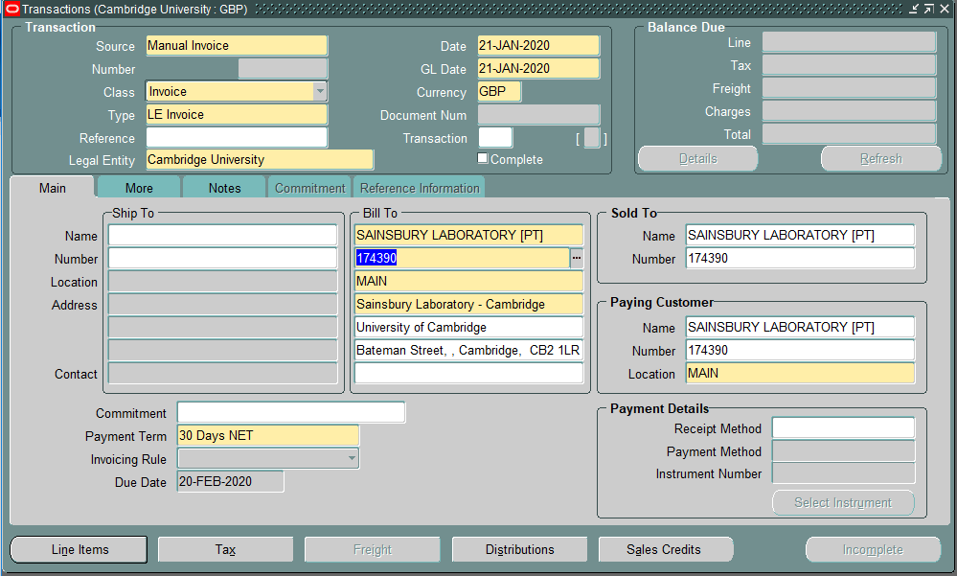
AR screen clean up

Slide 31
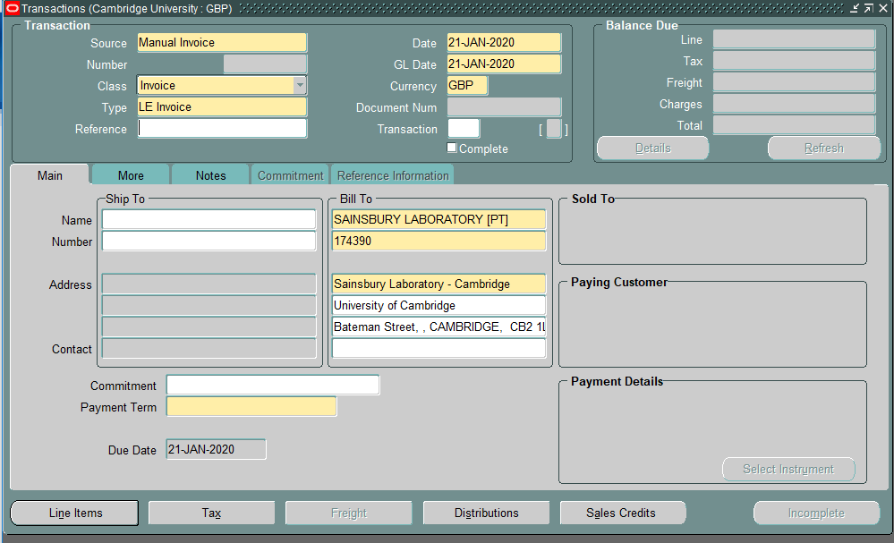
AR screen clean up

Slide 32
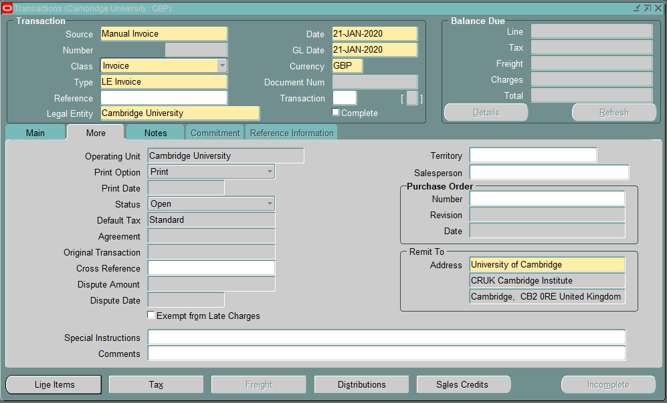
AR screen clean up

Slide 33
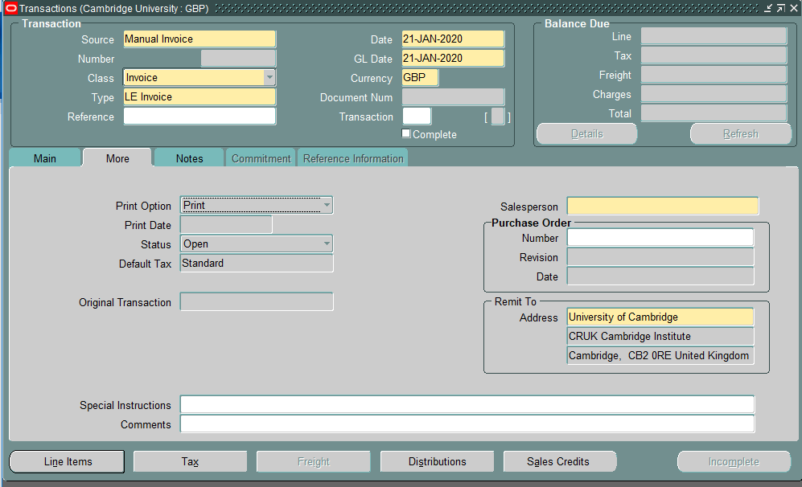
AR screen clean up

Slide 34
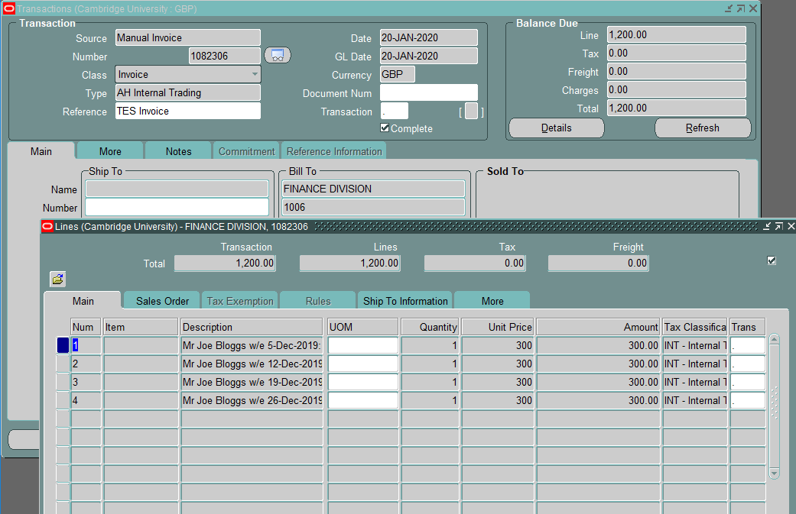
Internal invoices: AR to AP

Slide 35
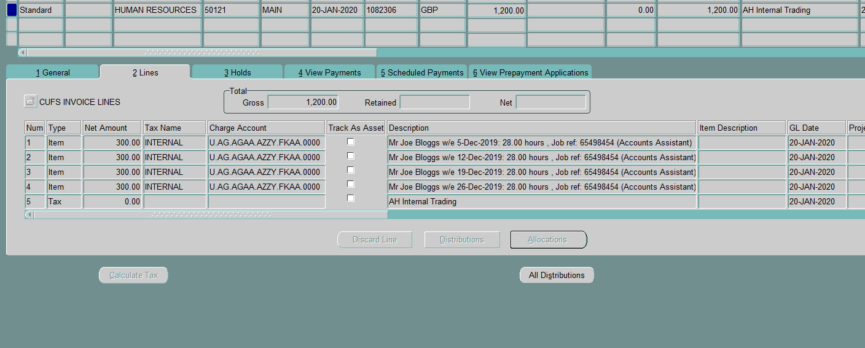
Internal invoices: AR to AP

Slide 36
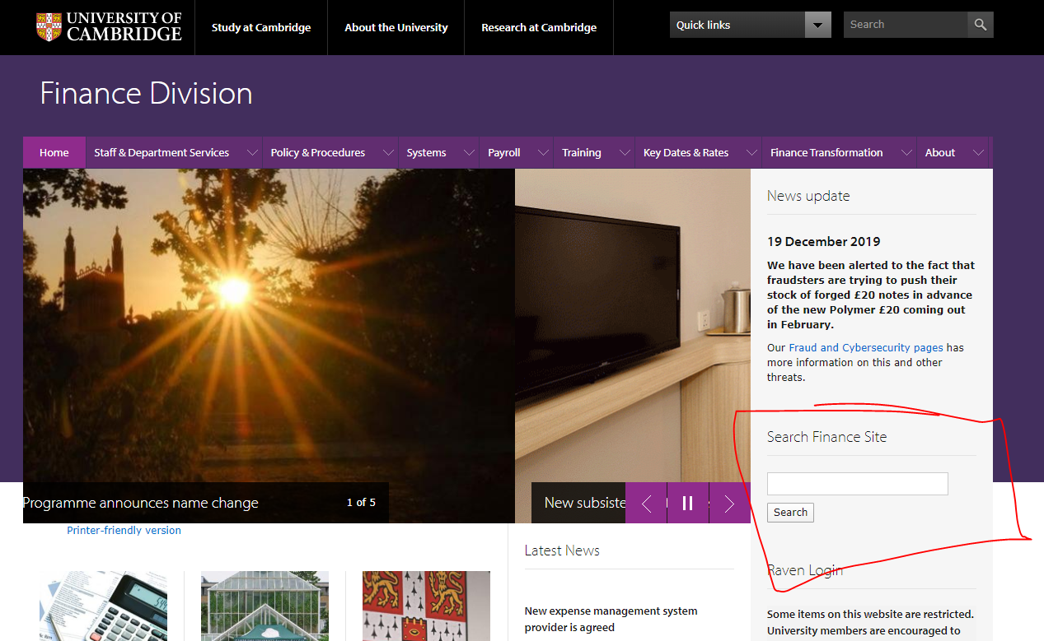
Finance web sites - searching
https://ufs.admin.cam.ac.uk/

Slide 37
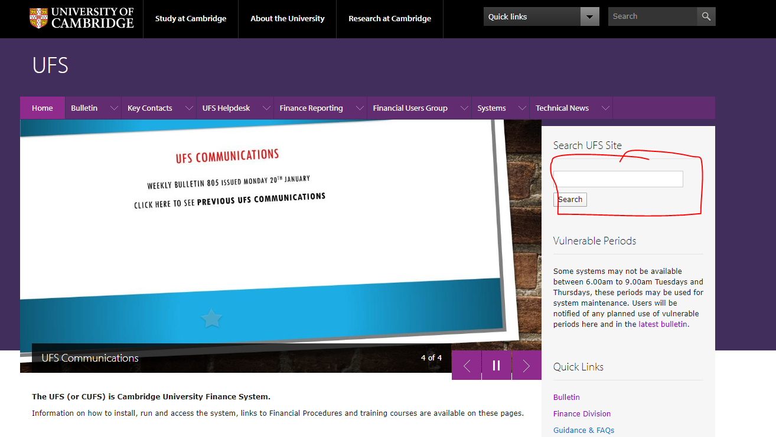
Finance web sites - searching
https://ufs.admin.cam.ac.uk/

Slide 38
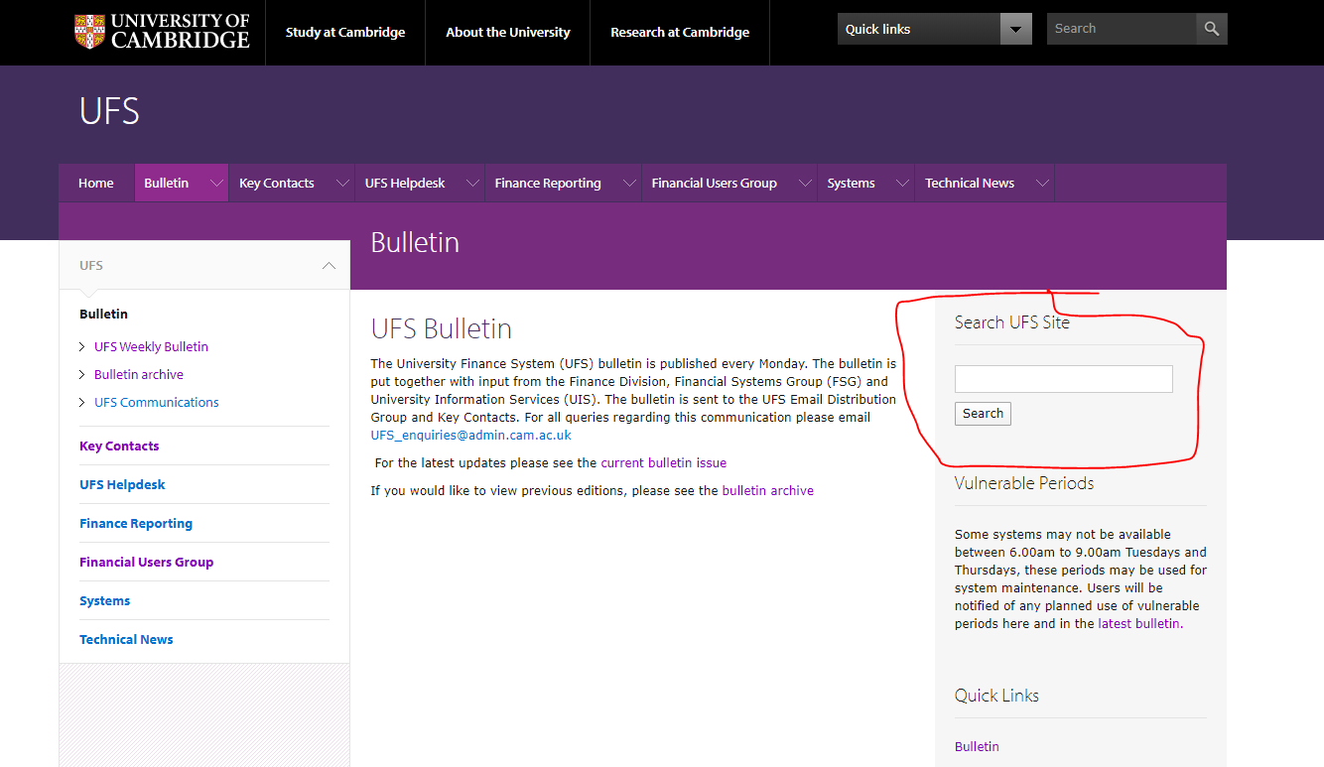
Finance web sites - searching
https://www.finance.admin.cam.ac.uk/

Slide 39
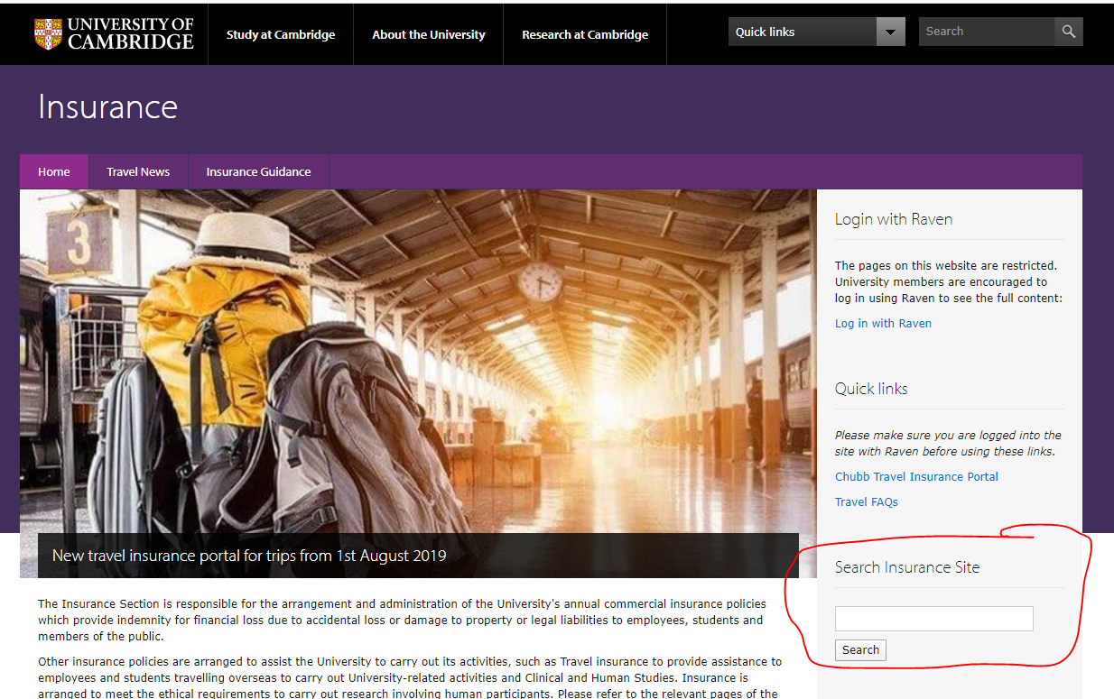
Finance web sites - searching
https://www.insurance.admin.cam.ac.uk/

Slide 40
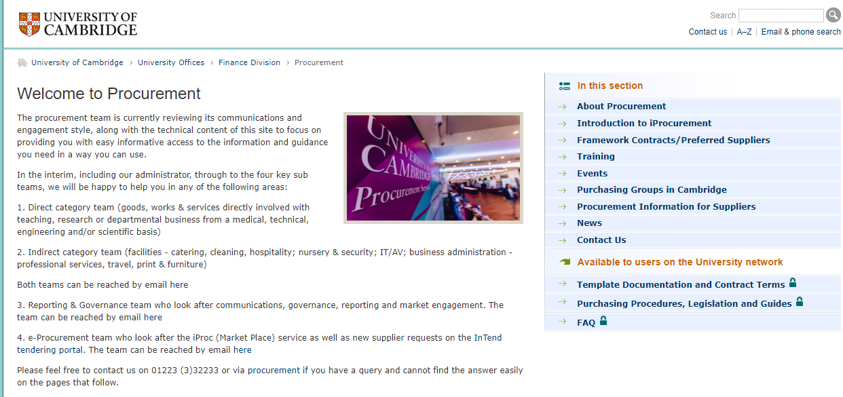
Finance web sites - searching
https://www.admin.cam.ac.uk/offices/purchasing/

Slide 41
2020 HALF-YEAR END
 | WD3 (AP, AR, GMS, INV, PO) Working day 3 | WD4 (Deposits and FA) Working day 4 | WD5 (GL) Working day 5
Jan 2020 | Mon 11 Feb 20 | Tue 12 Feb 20 | Wed 13 Feb 20
Review accounts
Reallocate expenditure to Research Grants, donations and Trust Funds
Raise any outstanding external trading invoices and recharges
Claim BACS receipts
Process all supplier invoices
Clear suspense accounts

Slide 42
Phishing

Slide 43
Fraudulent Purchase Orders

Slide 44
Questions?

Slide 46
Taster sessions …

Slide 47
Now I have got your attention …
Central & Research Accs.
AP & Cashier
Helpdesk & Cash Mang.
Finance Systems Group
Credit Control
GHOST
Do you want to understand more about what we do centrally?
Go to UTBS and look under the theme
Taster sessions for Depts.

