Slide 1
Financial Users Group
Friday 19th July

Slide 2
Agenda
Minutes of previous meeting
Matters arising / action points
Waste Reduction Initiatives
Finance Business Transformation Programme
Strategic Procurement Review
ourcambridge
General Finance Matters
AOB

Slide 3
Reducing Waste
Financial Users Group
19 July 2019
Peter Lumb, Environmental Coordinator, Environment & Energy Section

Slide 4
Reducing Waste
Current picture at Cambridge, and rationale for reducing waste
WarpIt – how it works
Other reuse options
Good practice examples and tips

Slide 5


The University’s Environmental Policy
Waste targets:
To send zero non-hazardous waste to landfill by 2020.
To achieve continuous year-on-year reductions in waste arising per FTE staff and students.
To recycle at least 95% of total waste produced at the University.

Slide 6


Waste at the University of Cambridge
The University of Cambridge generates over 10,000 tonnes of waste every year, just under a tonne per head…
Expenditure on waste disposal is £1.4m per year.
When staff were asked what ‘environmentally- conscious choices’ they want to make at work, the top option was recycling (93% of staff)…

Slide 7
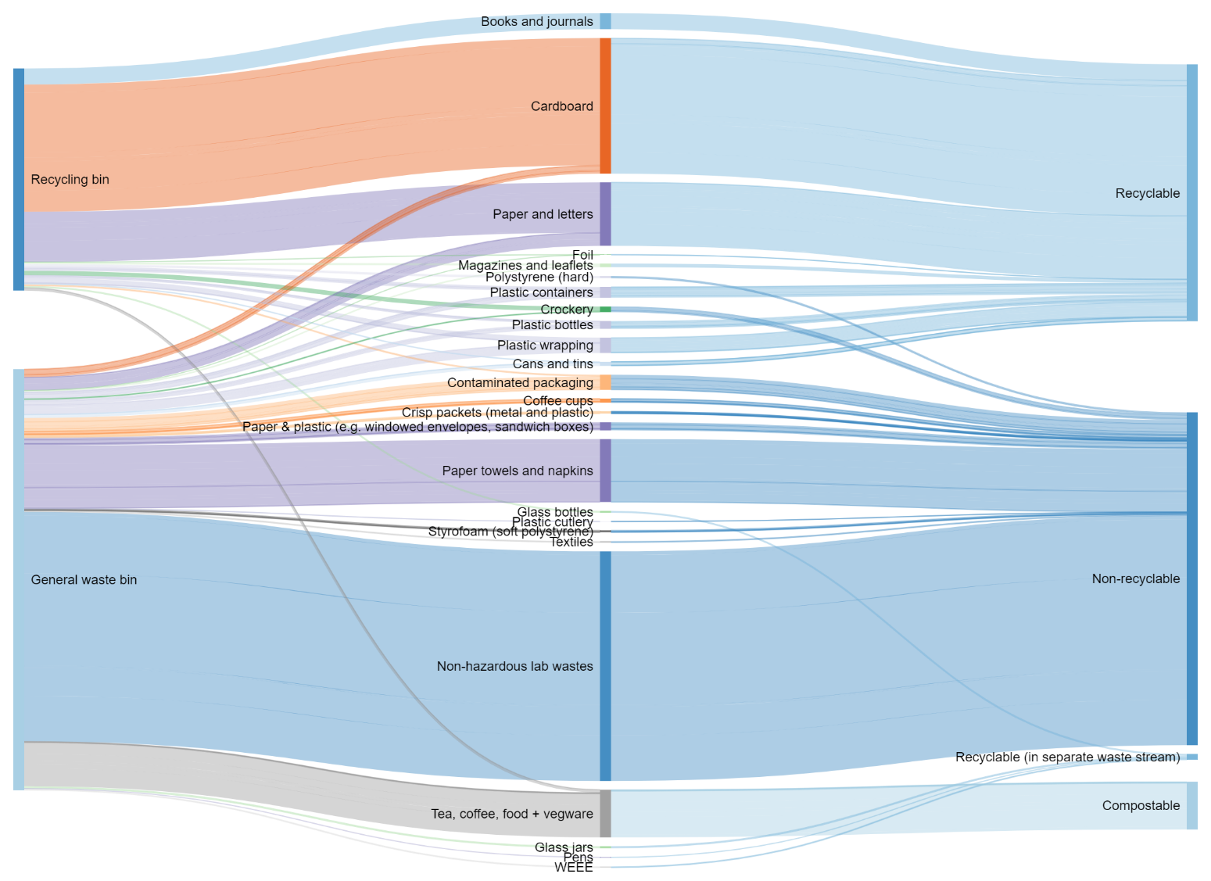

Slide 8


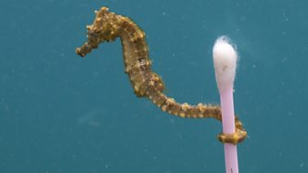


Global challenges
Globally, half of the waste in the world isn’t collected, treated or safely disposed of.
Only 9% of plastics are recycled, and 8.75 million tons of plastics end up in our oceans every year.

Slide 9

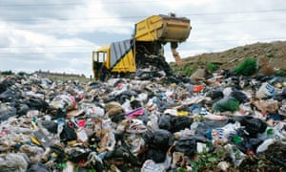
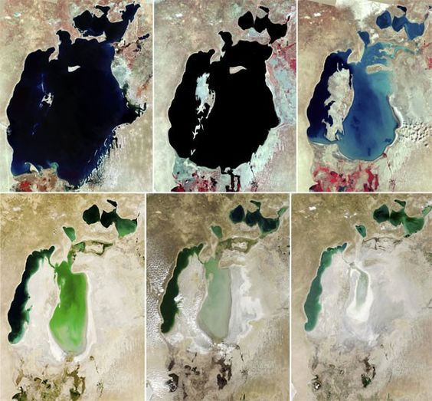
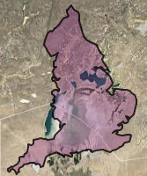




Wider environmental impact…
Plus the emissions created in production of the raw materials… (For 1 kg plastic it’s 3x as much again)
Source for carbon factors: www.gov.uk/government/collections/government-conversion-factors-for-company-reporting

Slide 10
Wider environmental impact…
Some materials have an even bigger impact … items For 1 kg clothing 22kg carbon is generated!
For every 1kg waste disposed of to landfill, 586g of carbon dioxide gas is emitted…
Plus the emissions created in production of the raw materials… (For 1 kg plastic it’s 3x as much again)
Source for carbon factors: www.gov.uk/government/collections/government-conversion-factors-for-company-reporting

Slide 11
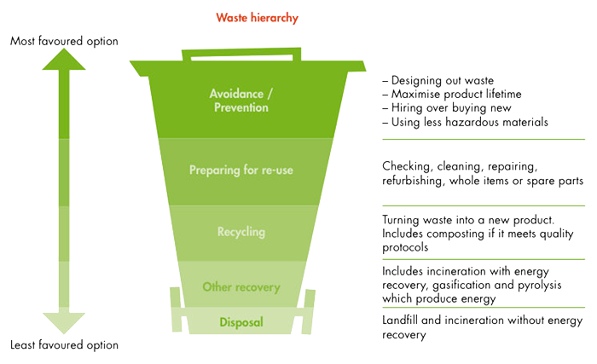
Move up the ‘Waste Hierarchy’ – buy less, re-use more

Slide 12
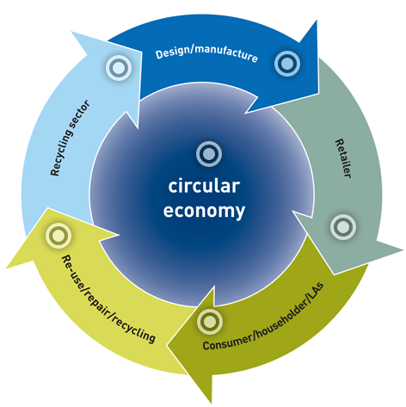
Move to a ‘circular economy’?
A circular economy is an alternative to a traditional linear economy (make, use, dispose) in which we keep resources in use for as long as possible, extract the maximum value from them whilst in use, then recover and regenerate products and materials at the end of each service life.
Benefits for us as a University…
Less money, time, space and effort dedicated to dealing with purchasing, invoices, suppliers, deliveries, waste disposal, etc…

Slide 13
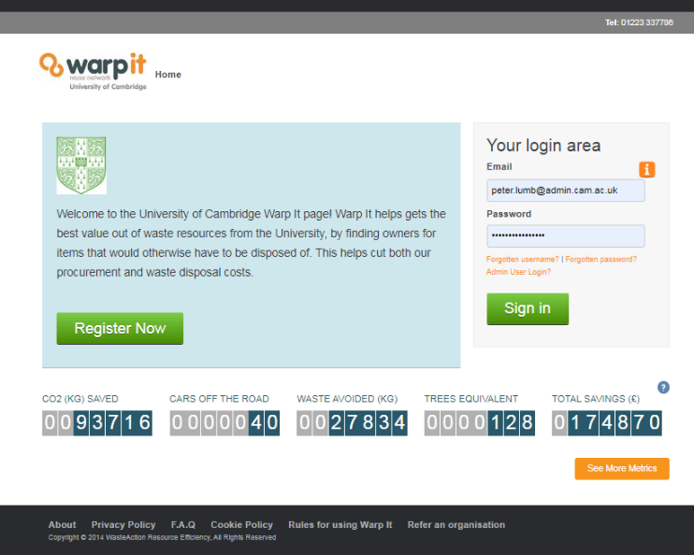
Support available - WarpIt
“Goods and services may be purchased externally only if they are not reasonably available elsewhere within the University”
- Section 18.6 of University financial regulations

Slide 14
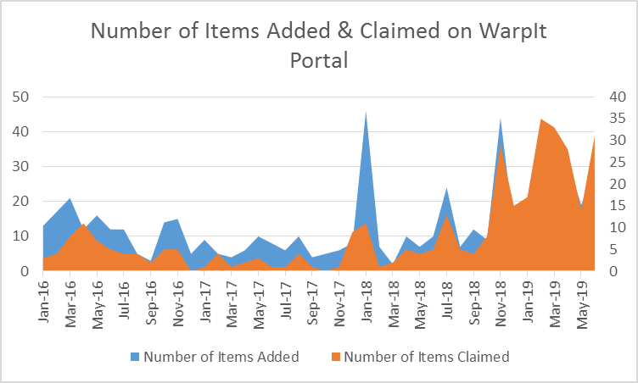
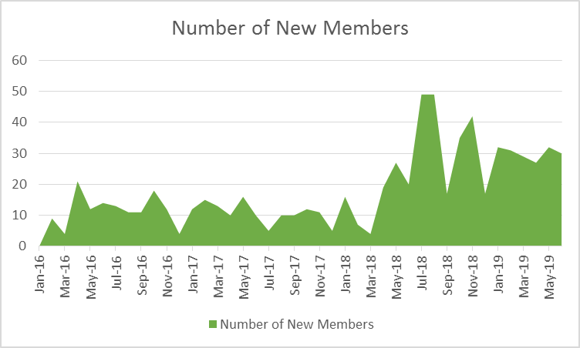
Since WarpIt was set up at Cambridge in 2014, it has saved £175,000 in avoided purchase and waste disposal costs.
In 2018-19, 20 items were added to Warpit, every month, with 80% successfully claimed.

Slide 15
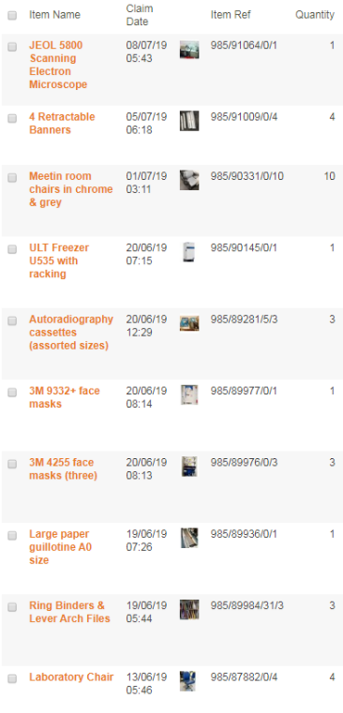
How it works
Log in or create an account at
www.warp-it.co.uk/cambridgeuni/
Anyone with an @cam email is accepted as a member automatically (others subject to approval by E&E team)
All members can both post items to the portal, and claim items from it.
Anything can be added to WarpIt (as long as permission has been given by the department to dispose of it, and the item is safe to use).
Items worth over £5000 at time of purchase cannot be posted without permission from central Finance team (as there is a need to update University asset register).

Slide 16
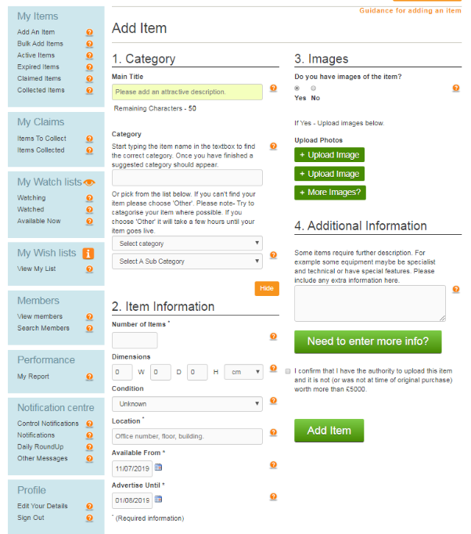
Useful features of WarpIt – Add item
Adding an item is quick and easy, simply add:
Title
Category (to ensure wishlist users are notified)
Quantify, approx. dimensions, condition, location.
Include availability if you need the item claimed by a certain date
Add images – more images will mean fewer queries!

Slide 17
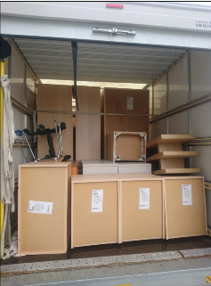

Useful features of WarpIt – extend posting, donate to charities
Items not claimed within intended time frame - extend the expiry date – simply log in, click the item you posted and edit the date.
During the last 5 days any item is advertised, it is automatically offered up to charities on the WarpIt portal.
Example: Multi-Faith Centre
clearout – significant saving
in skip hire and disposal costs
Note that item claims by individuals are discouraged – we want items to be reused within the University! However departments could choose to offer items to individuals if they aren’t claimed internally on WarpIt.

Slide 18
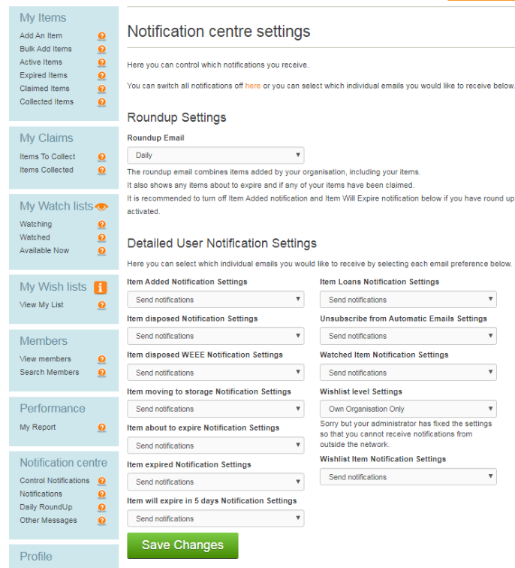
Useful features of WarpIt – Notification settings
Set notification settings – can receive notifications on Daily basis, Weekly basis, or not at all, however…
If you’re receiving too many notifications, you can edit your settings to only be notified when new items are posted, or when your wishlist items are added to the portal.

Slide 19
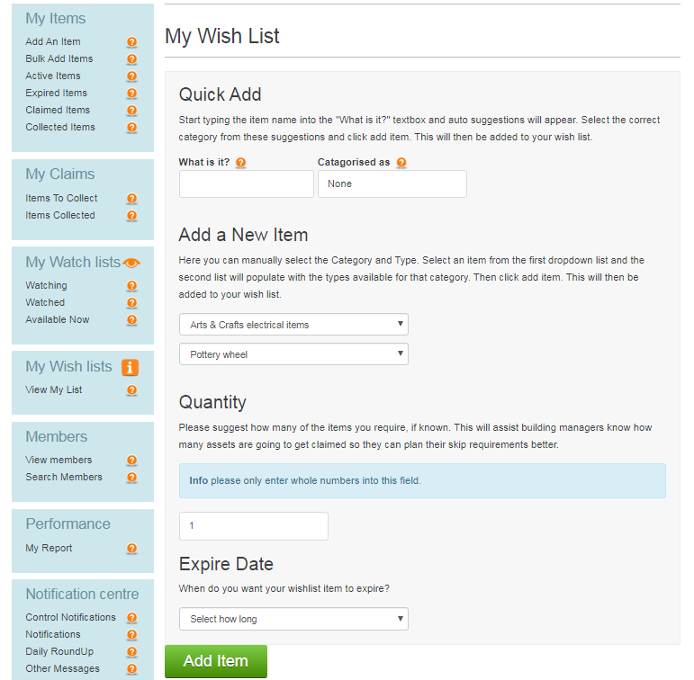
Useful features of WarpIt – Wish list
Wish list allows you to receive notifications when users in the University add an item matching your wishlist description.
Useful for if users who frequently buy certain items
Also useful if you are looking for a one-off item: other Warpit users in the University will be notified that you are looking for the item, and you can set an expiry date for your wishlist item.

Slide 20
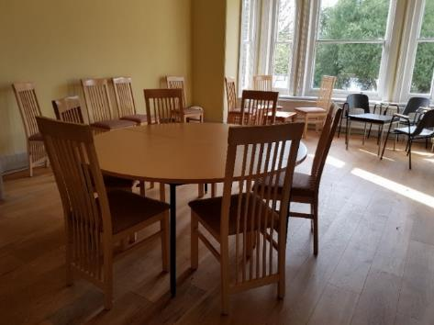
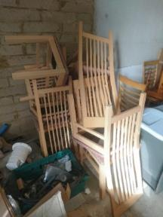

Examples
Fitzwilliam Museum’s saving by re-using surplus furniture from a project on the West Cambridge site.
Project Light (the relocation of departments in the Gleesson Building) resulted in £17.6k in savings to the University from re-used equipment and furniture
Our annual spend on furniture is ~£4m - plenty more potential! Key factor in success is to plan office moves as far in advance as possible.
If purchased new: £1,642
If disposed of: £233

Slide 21

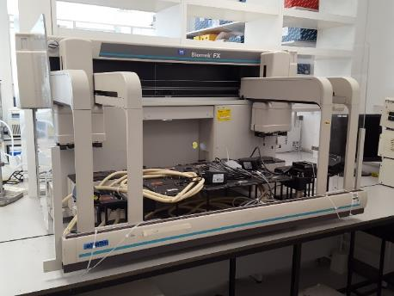
Other support available - UniGreenScheme
Service set up at Cambridge in 2018
Facilitates sale of surplus items, with rebate to department
Focused on higher-value equipment, particularly from labs
In one year the initiative has diverted 1,699kg of unwanted equipment from waste disposal, by selling it for re-use in other organisations.
This also resulted in rebates of £5,700 to University departments.
“This surplus Biomek FX was collected from the biomedical campus a few weeks ago. The department stopped using it around three years ago, it was then moved from lab to lab for two years without use because no-one wanted it but they didn't want to dispose of it, until we collected it for re-use.” – Michael, Unigreenscheme

Slide 22
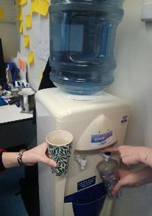
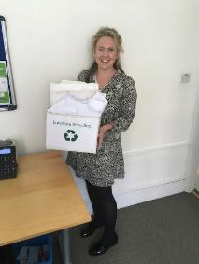
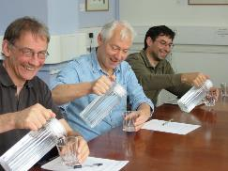
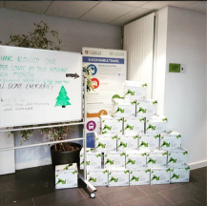
Other ideas for waste reduction
This year through the Green Impact initiative, many departments have taken action to eliminate waste:
25 departments had committed to providing reusable cups and/or eliminating disposable drinking cups altogether.
27 departments provided facilities for re-using envelopes for internal use.
24 departments ensured that duplex printing was the default option.
26 departments shifted to providing tap water rather than bottled water for meetings.
9 departments shifted to recycled or sustainably-sourced paper.
6 departments took proactive steps to reduce hand-outs taken to meetings or used in lectures.
Disposable cup elimination in the Department of Surgery
Envelope recycling at Meet Cambridge
Tap water replacing bottled water in Zoology
(Recycled) paper pyramid at Greenwich House

Slide 23

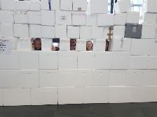
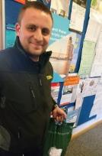
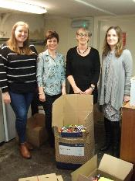
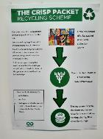
Other ideas for waste reduction
A number of departments also use supplier ‘take-back’ schemes:
BioPath stores are one of 15 departments using STARlab’s collection service for pipette racks and boxes.
Zoology are one of several departments using NEB’s return labels for polystyrene boxes.
Faculty of Philosophy use a coffee packaging take-back initiative.
The University Counselling Service has set up a successful pen and writing instrument recycling collection which raises funds for a local charity.
Greenwich House are one of several departments and sites using Walkers/Terracycle crisp packet recycling, while CISL use a similar KP ‘snack wrapper’ recycling initiative.
STARlab collections in PDN
CRUK polystyrene reduction and recycling initiative
Nespresso coffee pod collections in Philosophy
University Counselling Service’s charity writing instruments scheme
Crisp packet recycling in Alison Richard Building

Slide 24
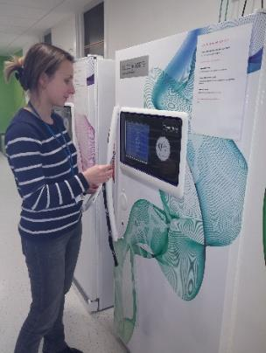
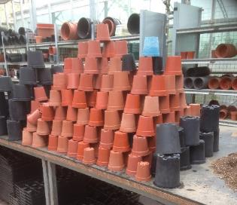
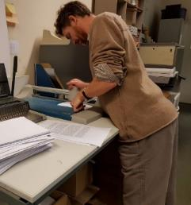
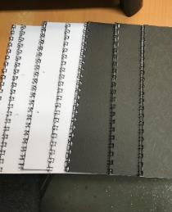
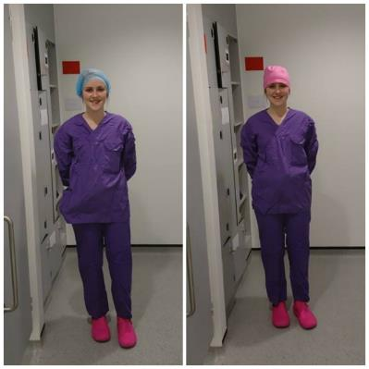
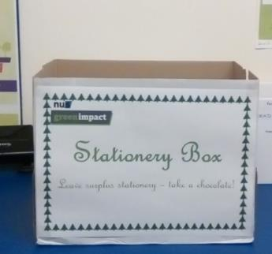
Ideas for waste reduction
Lab disposables vending machines in Dept of Medicine: Reduce waste by eliminating over-ordering and stock control issues, reduced packaging and dry ice received with deliveries, and saved £8,600 due to discounted purchasing costs.
Recycling pots at the Botanic Gardens
Reusable mob caps in University Biomedical Services
24
Stationary amnesty box at Psychiatry
‘Upcycling’ scrap paper as notebooks in CAU

Slide 25
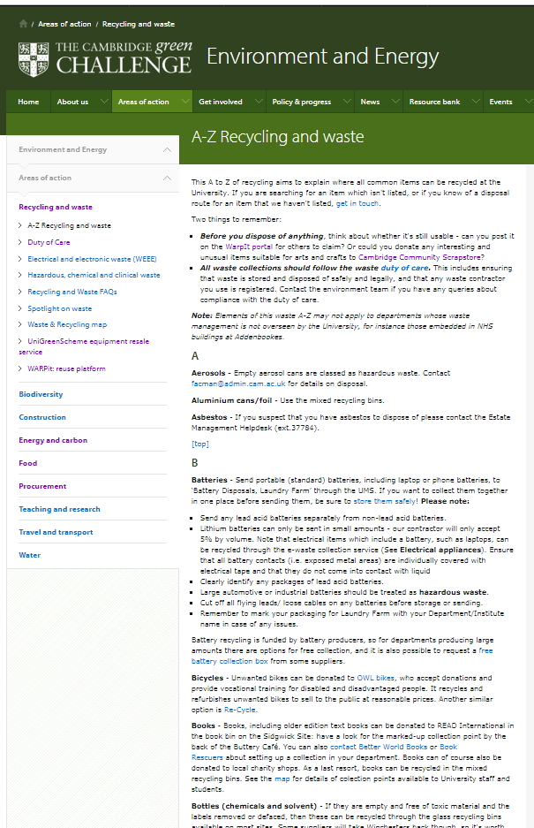
On our website…
Website ‘Recycling & waste A to Z www.environment.admin.cam.ac.uk/recyclingAtoZ
Currently 8 pages long, so let us know if something is missing or could be updated!

Slide 26
Key quick questions to ask
Alternative sources – are existing resources available or upgradeable?
Stock control - Is this something you purchase a lot of, that you think is unnecessary or wasteful? Are staff over-ordering supplies?
Lifecycle costs - Is the product made in part or wholly from recycled material? Can it be recycled after use? Is the product easy to dismantle (separating materials is essential for successful recycling)?
Avoiding single-use - Is there an option to purchase items which have a longer useful life? (for instance by preferring items which are refillable, reusable, rechargeable or more durable).
Suppliers and delivery - Can excessive packaging be avoided, orders consolidated? Is this a problem supplier who sends excess packaging? Will the supplier take back old items or waste packaging for reuse or recycling?

Slide 27
Contact us
Email:
Environment@admin.cam.ac.uk / Peter.Lumb@admin.cam.ac.uk
Website:
www.environment.admin.cam.ac.uk
Sign up to ‘Greenlines’ monthly newsletter:
www.environment.admin.cam.ac.uk/greenlines

Slide 28
Finance Business Transformation Programme
Financial Users Group
John Galvin, Interim Head of Finance Business Transformation
Friday 19th July 2019

Slide 29
Finance Business Transformation Programme
Agenda
Scope of the Programme
Vision and Objectives
How it will be governed and managed
Indicative Programme plan
Discovery Phase
Other Current Projects within the Programme

Slide 30
Finance Business Transformation Programme
Scope
Finance Business Transformation is a managed, co-ordinated programme that consists of multiple projects
Finance Business Transformation
CUFS Replacement/ Upgrade
Group Consolidation System
Strategic Procurement Review (SPR)
Expense Management
Current & Indicative Projects
Invoice Automation
Management Information
Planning & Analysis
Reporting
Finance Vision & Objectives
Programme Management
Communication & Change Management

Slide 31
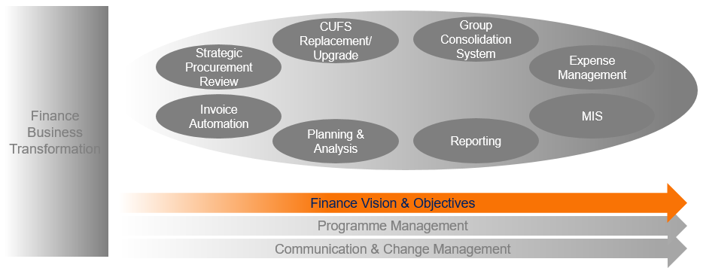
Finance Business Transformation Programme
Vision
“A Cambridge where research, education, support activities and growth are enabled by clear and sensible financial information, insight, tools and processes that are accessible for the thousands of academics and professional support staff at the University.”

Slide 32
Finance Business Transformation Programme
Objectives
The Programme has three
high-level objectives:
1. Identify and address gaps in financial information or insight, such as management information and performance management, in order to better support the University’s key strategic administration activities.
2. Introduce improved, harmonised and flexible end-to-end financial systems and workflows to make transactional and procurement tasks clearer and more transparent across Schools, Faculties, Departments and central offices.
3. Implement a better approach to designing and investing in the systems that support the University’s critical processes, in order to get better value for money.

Slide 33
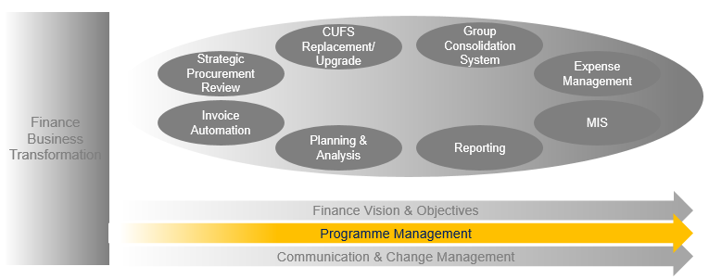
Finance Business Transformation Programme
How it will be governed and managed
Programme Team
Support
Co-ordination
Communication
Academic liaison
Programme Board
Programme governance
Programme delivery
Operational oversight
Risk management
Commissioning Board
Ultimate customer voice
Wide range of members
Customer-driven input
Decisions on content & priorities
Business design authority
Stakeholders
E.g.
OurCambridge
BSSC
Finance Committee
Associated committees
FUG
FSSC (or SPROG*)
Project governance, delivery and oversight
Escalation to Programme Board
Change board
Projects
Projects
Projects
Representative stakeholders, User groups, External support etc
* SPR only

Slide 34
Finance Business Transformation Programme
Indicative Programme Plan
Sep-Dec 2019
Jan-Jun 2020
Jul 2020-2021
2021-2022
‘As-is’ processes & data
Future business needs
Cost/benefit analysis
Risks & issues
‘To-be’ design of functionality & data flows
Impact of change analysis
Value proposition
Business data & processes redesign
Procure and develop
new systems
Testing & no-go criteria
Implementation of systems and processes
Training & comms
Benefits realisation
Monitoring
Phase 1 Discovery
Phase 2 Design
Phase 3 Develop
Phase 4 Deliver
Business Case
Review
Review
Strategic Procurement Review (SPR)
Tactical Projects
Group Consolidation System
Expense Management System
Other projects as they are identified

Slide 35
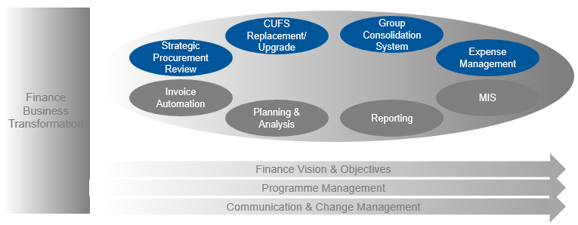
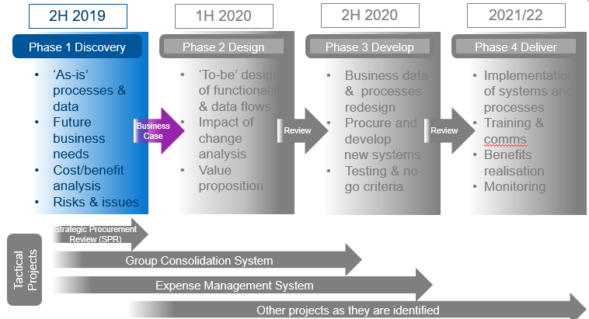
Finance Business Transformation Programme
Discovery Phase
The Discovery Phase is a key component of the Programme. It will enable us to understand the finance issues of academic and professional support staff across the University. While it will have a major systems component, its main focus will be on determining business needs, plus opportunities for improving finance functionality and end to end process efficiency.
It will lead to a Business Case for the full Programme, which will be submitted early 2020. This will include prioritised projects and workstreams such as the replacement of CUFS with a more modern finance system, plus enhanced processes and tools to fill gaps in key finance areas such as planning, reporting and invoice automation.
The Discovery Phase will be conducted by PA Consulting under management of the Programme team. It will last for 18 weeks, mainly across September to December. It will make full use of the pre-existing information already possessed by Finance Division. It will then seek user input and contributions from departments and schools, including online surveys, workshops, meetings and interactive events such as “World Cafés”. These will include a diverse set of University finance users such as academics, students and staff from other support functions.

Slide 36
Finance Business Transformation Programme
Other Current Projects
Project | Description | Funding | Status | User Impact
CUFS Upgrade | Contingency if CUFS replacement is not available before support expires end 2021 | Funded for commitments in next financial year | Project Initiation Document approved | Limited impact across all CUFS users
Expense Management System | Automated expense system | Pilot phase is funded | Project Initiation Document is being prepared | Pilot departments are under consideration
Group Consolidation System | New functionality to consolidate University group results | Fully funded | On track to go live for actuals at end July | Impacts Finance Division and subsidiaries
Strategic Procurement Review | Review of Procurement processes | Fully funded | Data collation underway | 25 departments taking part

Slide 37
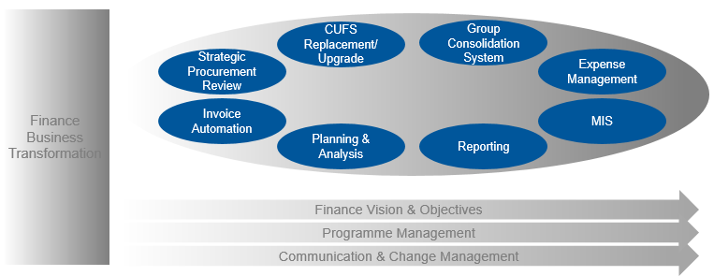
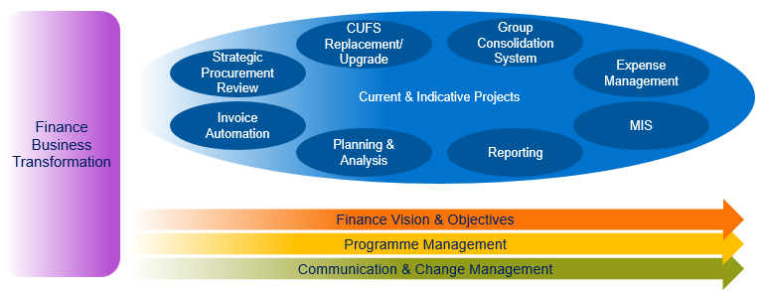
Finance Business Transformation Programme
Next Steps
Q&A

Slide 38
Strategic Procurement Review 2019
“A Cambridge where research, education, support activities and growth are enabled by clear and sensible financial information, insight, tools and processes that are accessible for the thousands of academics and professional support staff at the University”
Finance User Group
July 19th 2019

Slide 39
Strategic Procurement Review 2019 – scope, focus & objectives
Scope: A comprehensive procurement & purchasing review across the top 15 University departments by spend plus a further 10 departments ‘by ‘Head of School’ invitation’. Map, through cost & carbon modelling, a journey informed by differing stakeholders & good practice from ‘as is’ purchasing & procuring of goods, works & services to ‘could be’ covering:
Processes, practices & outcomes;
Systems, spend governance & control mechanisms;
Culture & behaviours influencing processes, practices, systems, governance & controls
Focus & objectives:
High level cost/benefit analysis measured in both GBP & carbon for each model with risk register;
Outline potential operating models for procurement & purchasing across the University;
Change programme mechanics – support through the transition ;
Harness accurate data to assist with informed decision making;
Propose & implement the right technology & system solutions;
Provides a user friendly experience ;
Attract, develop & invest in the right skill set;
Review & where required update policies & procedures

Slide 40
School | Department | Contact | Role
Arts & Humanities (Milly Bodfish/Claire Cahill) | Modern & Medieval Languages (nom) | Andy Kingsley | IT Manager
 | Architecture & History of Art (nom) | Neil Mayo | Senior Accounts Clerk
 | Centre for the Future of Intelligence/Centre for the Study of Existential Risk (nom) | Gaenor Moore | Research Grants Co-ordinator
Biological Sciences (Prof Abby Fowden/Michael Godfrey) | Biochemistry (core) | Alison Gelder | Procurement & Stores Manager
 | Gurdon Institute (core) | Helen Lonergan/Jane Course | Business Operations Manager/Finance Manager
 | Vet School (nom) | Matthew Moon/Gina Arnold | Director Veterinary Clinical Services/Finance Manager
Clinical Medicine (Prof Patrick Maxwell/Matt Burgess) | CRUK Cambridge Institute (core) | Sophie Duncan/Emma Ryley | Acting Directors of Operations
 | Medicine (core) | Stephen Walford | Business & Operations Manager
 | Public Health & Primary Care (core) | Emma Marron | Head of Operations
 | CIMR (nom) | Neil Kent/Dave Cheesman | Finance Officer/Laboratory & Facilities Manager
Humanities & Social Science (Prof Phil Allmendinger/Bev Housden) | Faculty of Education (nom) | Phil Gooding | Finance Manager
 | Faculty of History (nom) | Ed Mayes | Chief Accounts Clerk
Physical Sciences (Jim Bellingham/Susan Wright) | Physics (core) | Niall Taylor | Purchasing Supervisor
 | Chemistry (core) | Ann Searle | Finance Manager
 | Material Science & Metallurgy (core) | Derek Martin | Buyer
Technology (Prof John Dennis/Joanna Walmsley) | Engineering (core) | Anne Waldock/Mark Housden | Finance Manager/Purchasing Supervisor
 | Judge Business School (core) | Ali Stellings | Finance Manager
 | CISL (nom) | Andrew Wilkinson/Jane Batten | Director of Operations/Business Operations Manager
Unified Admin Service (Senior Officers/Mike Millard) | Estate Management (core) | Tom Walston | Head of Section
 | Research Operations Office (nom) | Jo Dekkers | Head of Department
 | University Biomedical Service (core) | Karl Wilson | Operations Director
Non School Institutions (Senior Officers/Diane Gaskin) | North-West Cambridge (core) | Heather Topel | Project Director
 | Information Services (core) | Fay Hider | Finance Officer
 | CUDAR (nom) | Michael Atkins | Finance Manager
 | University Library (core) | Ben Perks | Head of Finance

Slide 41
Strategic Procurement Review 2019 – phased activities
Roll out University communication plan
Data room creation
Departmental engagement
Population of data room
Secure systems access
Secure needs for phase 1
Review & map current procurement & purchasing practice, process, policies, controls & governance
Map ‘as-is’ systems & data flow
User engagement activities ‘what good could look like’
Initial opportunities for change
Benchmark findings to sector & industry best in class
Review options for future operating model & structure
Identify hurdles & develop mitigating action plan
Outline potential opportunities, outcomes & needs to a timeline
Propose ‘could be’ systems & processes
Training & communication recommendations
High level cost/benefit analysis with risk register
Phase 0: Enable
& Engage
Phase 1: Discovery
Phase 2: Interpret
Phase 3: Conclude
& Propose
May 22nd - July 18th
July 22nd – Sept 6th
Sept 9th – Oct 4th
Oct 7th – Nov 4th
Delivered by UoC
Delivered in partnership by PA Consulting
NB: PA Consulting resources & timing for Phase 1 – 3 to be confirmed

Slide 42
Strategic Procurement Review 2019 - engagement
10
Face to face interviews executive sponsors
2 x 25 attendees
Facilitated professional workshops
( nominated procurement/purchasing SMEs)
2 x 150 attendees
Facilitated World Café events
(nominated academic/academic related/admin)
25 sample departments
On line survey
(Open to all staff within the 25 departments)
25 departments as sample of University
Off line data collection
(conference calls & briefing notes)
Notes:
As at 15.07.19 = 10 off workshop one (Aug 15th), 15 off workshop two (Aug 6t^{h}). World Cafes 24/26 each World Café Aug 8th & 20th F2F all booked except UIS, Estates

Slide 43
Governance & feedback
Our Cambridge
Business System Strategy Committee
Finance Committee
Audit Committee
Commissioning Board
Etc
Programme Board
PSG
Period programme board and procurement strategy group (PSG) reviews
SPROG
SPROG
Regular strategic procurement review operating group (SPROG) reviews
Wk1
SPROG
Wk1
Wk1
Wk1
Wk1
Weekly progress reviews with project team
Wk14

Slide 44
Thank you – questions?

Slide 45
Finance Training
Karen Sheldon

Slide 46

Travel Insurance update
Chubb web portal now live
https://universityofcambridge.chubbinstanda.com/Public/Index
Migration of existing travellers to the Chubb policy.
Underway centrally.
1 Aug: Chubb will email migrated travellers with new policy details
Q. Cover for mobile phones, devices and laptops ?
There is no cover for accidental damage or loss for these regardless of whether they are University or personally owned.
BUT
They are covered for theft under either “Personal belongings” or “Business equipment”
Q. Does it cover undergraduates away on their compulsory year abroad ?
No – this additional cover was considered but didn’t go ahead
Use for ..
All trips starting on or after 1 Aug
any trips returning on or after 1 Sep
Notes:
New Insurer from 1st August
Cover comparable with current policy with no country or pre-existing medical condition exclusions.
Family members accompanying employees on University business trips can still be covered.
To maintain a reasonable premium there will be an increased excess for baggage, cancellation and travel rearrangement costs to £100 and accidental damage to mobile phones and laptops will be excluded.
The new insurers web portal will be launched soon with enhanced features
To ensure that cancelation cover is in place, continue to book insurance through the existing website at the time the travel arrangements are made, including trips or commencing after 31st July or continuing beyond 1st August.
Insurance cover already arranged will be automatically transferred to the new insurer from 1st August.
More details will be announced shortly via Bulletin and to Administrators

Slide 47

Modern Slavery Act online course
Requirement for new:
Credit card applicants/administrators
Petty cash administrators
Users requesting new suppliers
Key contacts
Requests for cash advances
CUFS transactional users *
( * Requisitioners – within six months)
Regarded as mandatory for existing users in above categories
Highly recommended for purchasing staff/decision makers and accounts staff
GO LIVE next week

Slide 48

AAT programmes next year
Level 3
Sept 19 – Jun 20
5 exams , 24 days
Dept. contribution £800
University L3 and L4 both to be run off site at First Intuition
Applications open next week – see
https://www.finance.admin.cam.ac.uk/training/professional-qualifications/aat
closing date Fri 16th August
Level 4
Sept 19 until at least Aug 20
6 exams, 30 days
Dept. contribution £1000

Slide 49
General Finance Matters including ourcambridge
Finance User Group
19 July 2019
Stephen Kent-Taylor and Chris Patten
Notes:
49
49

Slide 50
What is it?
Programme asking staff to submit ideas to help improve the University:
Supporting our staff
Simplifying our processes
Started off with launch events and then workshops
Staff can submit ideas online:
ourcambridge@admin.cam.ac.uk
https://www.ourcambridge.admin.cam.ac.uk/submit-idea
Notes:
Key points:
Get things in early
22 Dec payment run will include payments up to 4 Jan

Slide 51
Update
UDA: still reviewing: will update at future FUGs
BACS list: we are trialling some changes
IPOs:
Changes have already improved processes in payments team and SSF.
Have some more changes we can put in place fairly quickly and will monitor effect.
Notes:
Key points:
Get things in early
22 Dec payment run will include payments up to 4 Jan

Slide 52
Still listening…
Please continue to submit suggestions (even if you think someone else may have already submitted it).
https://www.ourcambridge.admin.cam.ac.uk/submit-idea
We will continue to give updates at FUG.
Notes:
Key points:
Get things in early
22 Dec payment run will include payments up to 4 Jan

Slide 53

Expenses
We’ll be reviewing the policy as we look to move towards a new system.
Please submit your suggestions and any areas you’d like to see addressed.
Notes:
Key points:
Get things in early
22 Dec payment run will include payments up to 4 Jan

Slide 54
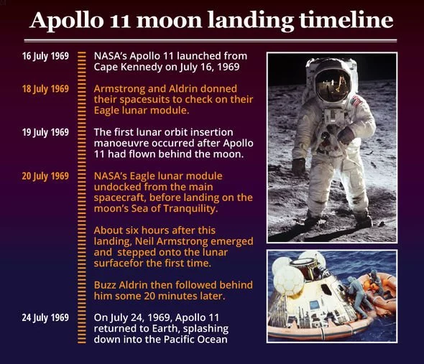
Notes:
Key points:
Get things in early
22 Dec payment run will include payments up to 4 Jan

Slide 55



