Slide 1
A brief history of CBU and the latest chapter: the move to the University of Cambridge
Victoria White
MRC Cognition and Brain Sciences Unit
06.06.18

Slide 2
Content
Introduction
War-time work
Post war work
What went well?
Even better if…

Slide 3
Unit established in 1944, APU with fewer than 20 researchers.
Unit renamed in 1998, CBSU with considerably more than 100 researchers.
Cumulative success as largest and most long-term contributor to development of psychological theory and practice in the UK.

Slide 4
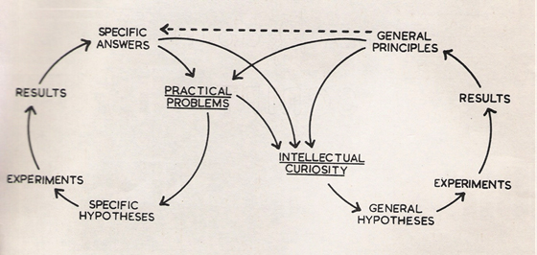
An early depiction by Mackworth (1955) illustrating relationships between applied research and general scientific principles.

Slide 5
War time research (left to right): SMA-3 pilot aptitude test, Cambridge cockpit, Mackworth clock, Fighter Control Rooms, Bomb-aiming apparatus.

Slide 6
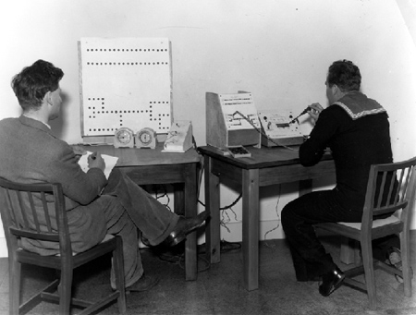
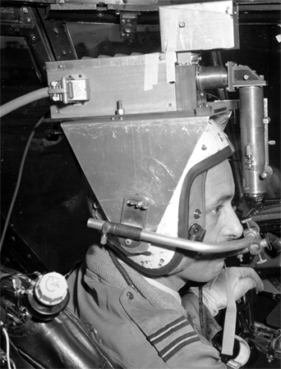
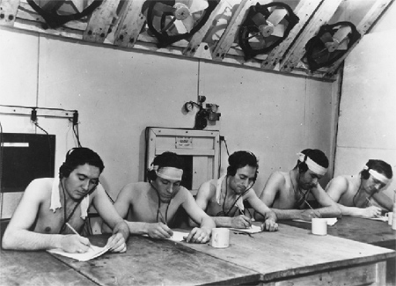
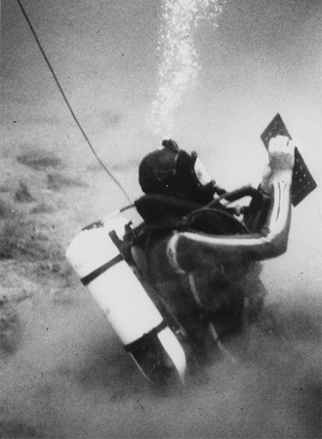
More photos from the archive…..

Slide 7
Sample of bespoke equipment and apparatus used in research

Slide 8
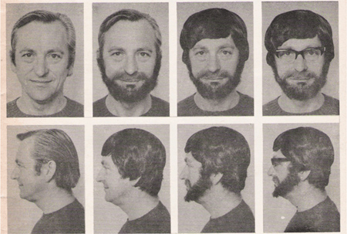
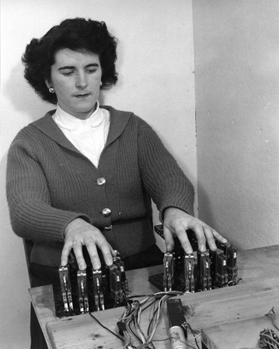
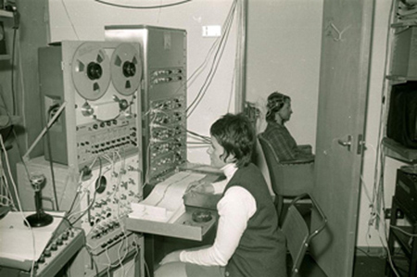
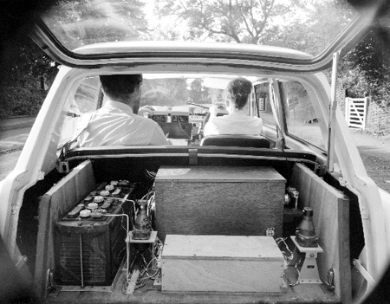
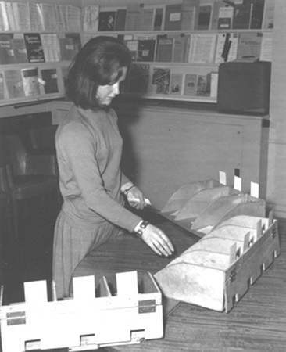
Some additional archive highlights….

Slide 9
What went well…
Initial UoC training
Petty
cash
Research grant
and pricing tool
Expenses in Excel
Choice of reporting/analysis tools
UPS 5
Volunteer cash
Finance
Network
01223 (7)62999
Notes:
Initial UoC training and CUFS sandpit to see how it might look and what might be able to do… (revised down when appreciate set up as part of UoC shared services and bulk of transactions are in Grants Module, not general ledger – I don’t even do the credit card posting, although I did the first one)
X5 is a strong system to cost grant applications – salaries and overheads – easy to use with clear rules and applicable rates.
UoC Responsive:
petty cash limited increased while right additional buyers added to CBU team
C/O SKT now have a range of reporting and analysis tools to share information with PLs
Excel template created to replace existing Word format expenses form
Volunteer cash request time reduced, instead of 5 days to process, became 3 days and on one occasion even seen it done in 24 hours!
And the BIG one, UPS5, a bespoke solution for size of cash demanded in CBU transactions and the UoC insurance restrictions. UPS5 supplements cash payments to volunteers, we can also nominate an individual bank transfer payment to be settled a little later (in line with an agreed schedule).

Slide 10
Even better if…
Last few transferred external grants with a remaining error in set up corrected before UoC year end
Received invoices on hold list before Dec 2017
Established how ROO budgets talk to CUFS and iProc to avoid “funds failures” and “not permitted transaction code” errors
Understood UoC Central costs and charging mechanism agreed with MRC before May 2018
Contracts and collaborations set up needed less chasing

Slide 11
Thank you to our local UoC support teams for all the help and guidance they give the staff, visitors and students of MRC-CBU.

