Slide 1

Finance Systems Update
Paul Humphreys
Functional Analyst
paul.humphreys@admin.cam.ac.uk

Slide 2
Passphrases to replace passwords – July 18
Passphrase - 13 characters or more
A users passphrase will not expire automatically
Guide: choose three random words that have meaning to you but that would not be easily guessed.
You must keep your passphrase and user name secure –
do not share them.
You must reset your passphrase immediately if you suspect this has become known by others

Slide 3
RG Re-numbering – change Aug/Sept 2018
From
RG12345
System changes in:
CUFS
Reporting
RCO database
X5
CHRIS
To
G123456
Other impacts? Let us know….

Slide 4

Reporting:
Cognos overhaul and ongoing improvements
Reporting User Groups:
  School Finance
  Departmental
  Central Finance

Slide 5


Slide 6
Shared Services Update
6th June 2018
Bernadette Parsons
Shared Services Manager
Finance Division

Slide 7
Happening now
PODS within the SSF team operating since April with a School focused area of responsibility
Early data shows good improvement in our turnaround times since the POD introduction. Now working within the 5 day SLA for non-clinical school PODS
Prioritising the SIA on IPOs & expenses.
Fast track expenses working well, 330 batches processed since April. 1130 claims. Queries mainly bank details incorrect.
Catch up from GH occupation.
Invoice scanning pilot.

Slide 8
Coming soon
Fast track expenses cut off moving to c.o.b. Wed for payment Mon
Align CS POD batches into the SSF protocols for received date
Redesign the Shared Services Website
Update training materials for users of Shared Services
Department visits
Invoice scanning further roll out
Year end

Slide 9
General Finance Matters
Chris Patten and Stephen Kent Taylor

Slide 10

Barclaycard processing
Statement date will be end of the month, downloadable from the next day.
There are 2 statements to deal with
in May: 11th and 31st.
Source of funds default will be AZZY (effective from 30 June bill). Any balance on this source of funds should be cleared.

Slide 11


Greenwich House

Slide 12

Bank charges on IPOs
Reminder: no longer enter an invoice for bank charges on IPOs.
These are now journaled to grants/GL codes. Description on journal includes:
IPO reference
Invoice number
Supplier name (first 20 characters)
Invoice description (first 20
characters)
Will move to monthly process following a period of close monitoring while running the process more frequently.

Slide 13
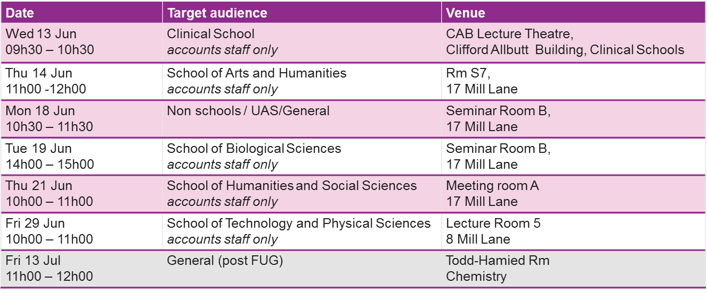
Year end prep
Extended June month-end close (four extra days) – aim to reduce time pressure at year end
Year end seminars:
New user workshop, Greenwich House, Tue 10 Jul 09h30 – 12h30

Slide 14

Pectus prospectus
The project to change how the Chest Allocation works has been given the thumbs up
Expect us to provide a conspectus on how Pectus will affect us?
TBC - be at the next FUG at Chemistry
XIII · VII · MMXVIII

Slide 15
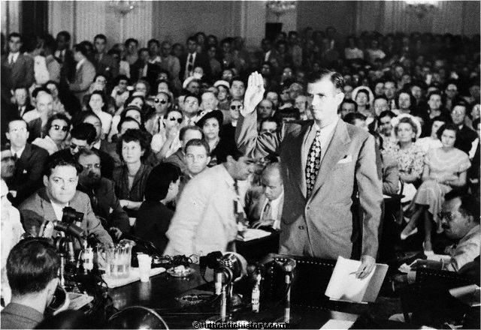
Questions?

